Slide 1

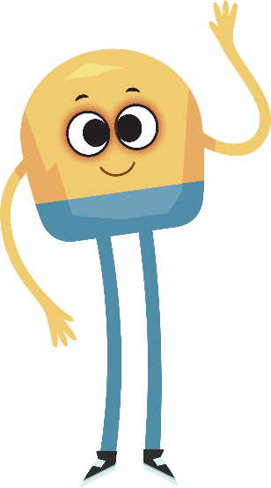

Unit 2: Week 2
Grade K

Slide 2
Copyright © Savvas Learning Company LLC. All Rights Reserved.
This publication is protected by copyright, and permission should be obtained from the publisher prior to any prohibited reproduction, storage in a retrieval system, or transmission in any form or by any means, electronic, mechanical, photocopying, recording, or otherwise. For information regarding permissions, request forms, and the appropriate contacts within the Savvas Learning Company Rights Management group, please send your query to:
Savvas Learning Company LLC, 15 East Midland Avenue, Paramus, NJ 07652
or
k12learningpermissions@savvas.com
myView Literacy® is an exclusive trademark of Savvas Learning Company LLC in the U.S. and/or other countries.

Slide 3

Lesson 1

Slide 4
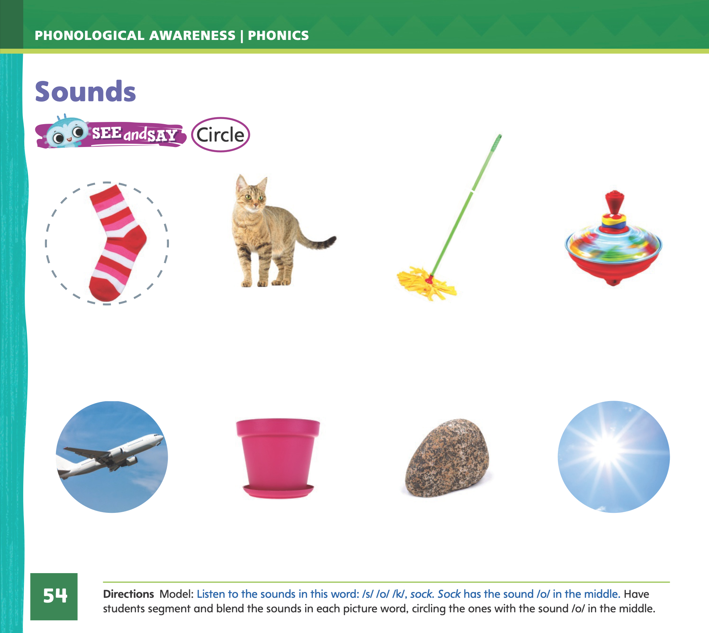
Page 54
Phonological Awareness
Turn to page 54 in your Student Interactive.
Notes:
Tell students that today they will learn a new sound. Listen carefully as I say the new sound: /o/ /o/ /o/. The sound /o/ is made by opening your mouth and dropping your jaw. Show students how to make the sound /o/ and have them practice it.
Tell students they can segment, or take apart, and blend, or put together, the sounds in a word. Listen to this word: hop. Now listen as I take apart the sounds in the word: /h/ /o/ /p/. I hear our new sound /o/ in the middle. Now listen as I put the sounds together again to say the word: hop.
See and Say: Have students segment and blend the sounds in each picture word on p. 54 in the Student Interactive and circle all the words with the sound /o/.

Slide 5
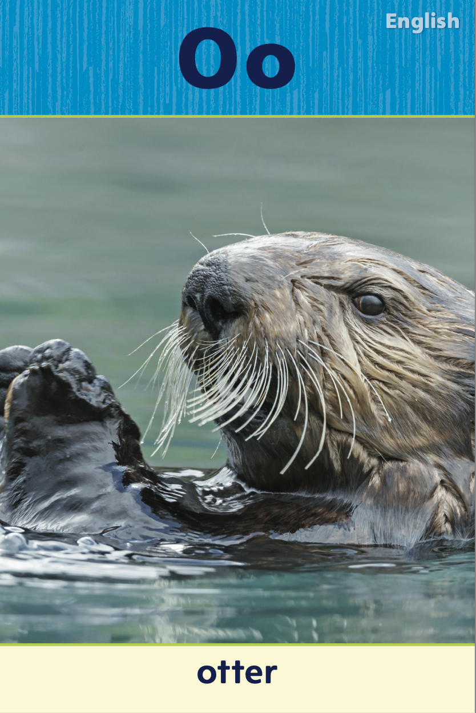
Phonics
top
box
hot
job
pop
mom
hop
rob
Notes:
Hold up the Oo Alphabet Card and point to the picture of the otter. Let’s say the sound at the beginning of the word otter: /o/ -tter, /o/. The sound /o/ is spelled with the letter o. Point to the letters Oo on the Alphabet Card. Tell students the word otter begins with the sound /o/, so it begins with the letter o. Click path -> Table of Contents -> Unit 2 Week 2 Informational Text -> Lesson 1
Write the letters Oo on the board. Tell students that you will say a word that has the sound /o/ in the middle. They will listen for the middle sound /o/ and trace the letter o in the air as you say each word. Use these words, emphasizing the sound /o/: top, box, hot, job, pop, mom, hop, Rob.

Slide 6
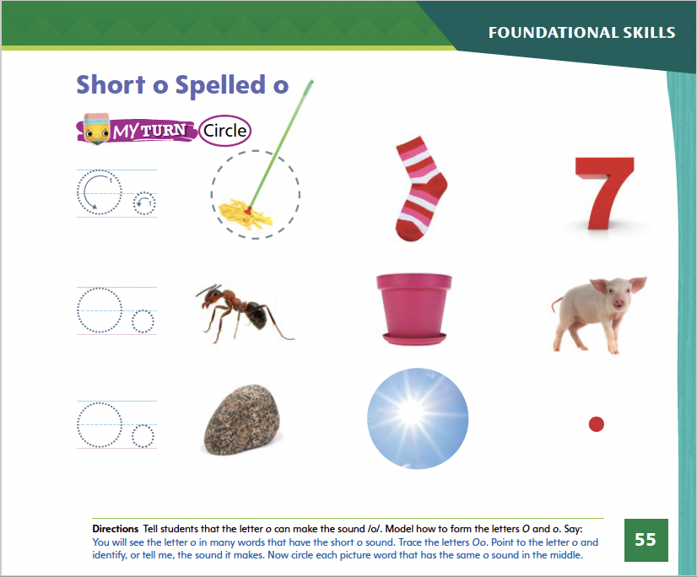
Page 55
Phonics
Turn to page 55 in your Student Interactive and complete the activity.
Notes:
Direct students to the first picture on p. 55 in Student Interactive. Say: Trace the letter o and identify, or tell me, the sound it makes. Now circle each picture word that has the sound /o/. Does the word mop include the sound /o/? Yes, it does, so we will circle it. Tell students to complete the activity.

Slide 7
High-Frequency Words
they
you
do
Notes:
Display the high-frequency words they, you, and do. Show students familiar letter sounds, such as d /d/, in these words.
Point to the word do and read it.
Have students identify the word do by pointing to it, and then have them read it.
Repeat for you and they.

Slide 8
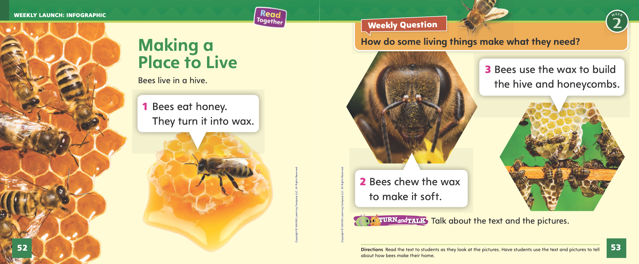
Page 52, 53
Interact with Sources
Essential Question: What do living things need?
Weekly Question: How do some living things make what they need?
Notes:
Remind students of the Essential Question for Unit 2: What do living things need? Point out the Week 2 Question: How do some living things make what they need? Explain that students will learn about animals this week.
Have students follow along as you turn to p. 52 of the Student Interactive and point to the picture of the bees. Explain that animals need homes. A bee’s home is a beehive. Tell students that bees make their own homes. Then read the infographic, “Making a Place to Live.”
Use the following prompts to guide discussion:
Ask students to look at the picture on p. 52 and tell what they see.
Have students act out the process of chewing the wax.
Have students look at the final picture. Ask them what the bees build with the wax.
Tell students to ask questions about the infographic to clarify any information they do not understand.
Weekly Question: Remind students of the Week 2 Question: How do some living things make what they need? Tell students that they just learned how one living thing, a bee, makes what it needs. A bee makes a hive and honeycombs using honey. Explain that other animals make what they need too, and students will read more about them this week.

Slide 9
Listening Comprehension
What Animals Need
food
Notes:
Tell students that they will listen to an informational text. Informational texts give facts and details about real people, places, and things. They have a main idea and details. Have students listen as you read aloud the informational text, “What Animals Need.” Tell students to be active listeners by looking at you and thinking about what you are saying as you read aloud.
Have students listen actively to elements of informational text, such as the main idea and details.
Read the entire text aloud without stopping for the Think Aloud callouts.
Reread the text aloud, pausing to model the Think Aloud strategies related to informational text.
Use the chart to help students identify details about what animals need.

Slide 10
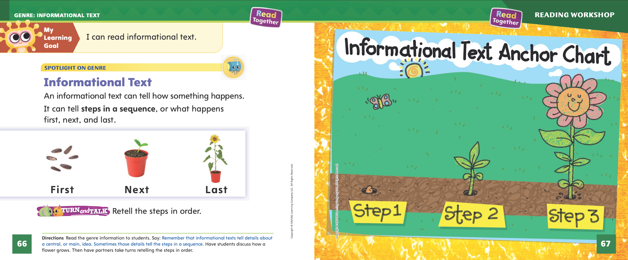
Page 66, 67
Informational Text
Turn to page 66 in your Student Interactive.
Notes:
Tell students that an informational text has a main idea and details. An author puts the details in order to make the content easy for the reader to understand. An author can use different patterns to organize details. If the details always go in a specific order, it creates a sequence.
Have students turn to p. 66 in the Student Interactive. Point out the three pictures showing first, next, and last. These pictures show a sequence of events. First, the seeds are planted. Next, the seeds sprout. Last, the flower blooms. These events must go in a specific order. Can you think of anything else that must be done in a specific order? Allow students time to think of a sequential order like washing hands, hitting a baseball, etc.
Talk about other informational texts that contain a sequential order. Discuss how the details go in order to provide clarity for the reader. Then ask students to identify the order in the informational text “What Animals Need.” Provide assistance as needed. Editable Anchor Chart Click Path: Table of Contents -> Reading Anchor Charts -> Unit 2 Week 2: Informational Text Editable Reading Anchor Chart: Text Features

Slide 11
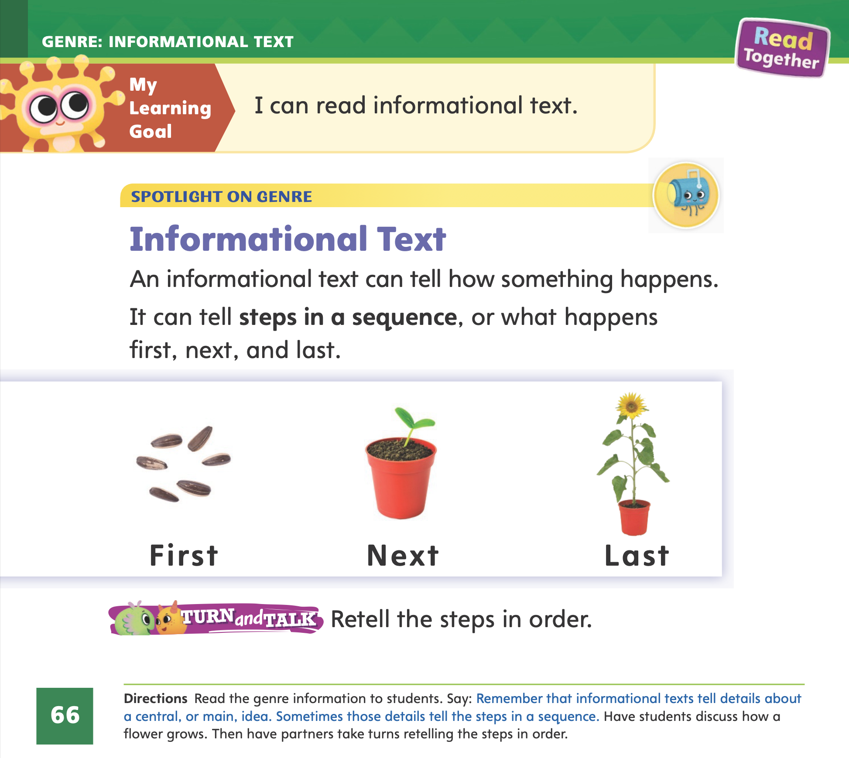

Page 66
Apply
Retell the steps in order.
Notes:
Have students use the strategies for identifying order within informational text.
Have students work with a partner to complete the Turn and Talk activity on p. 66 of the Student Interactive. Circulate to discover if students can retell the steps in order.

Slide 12
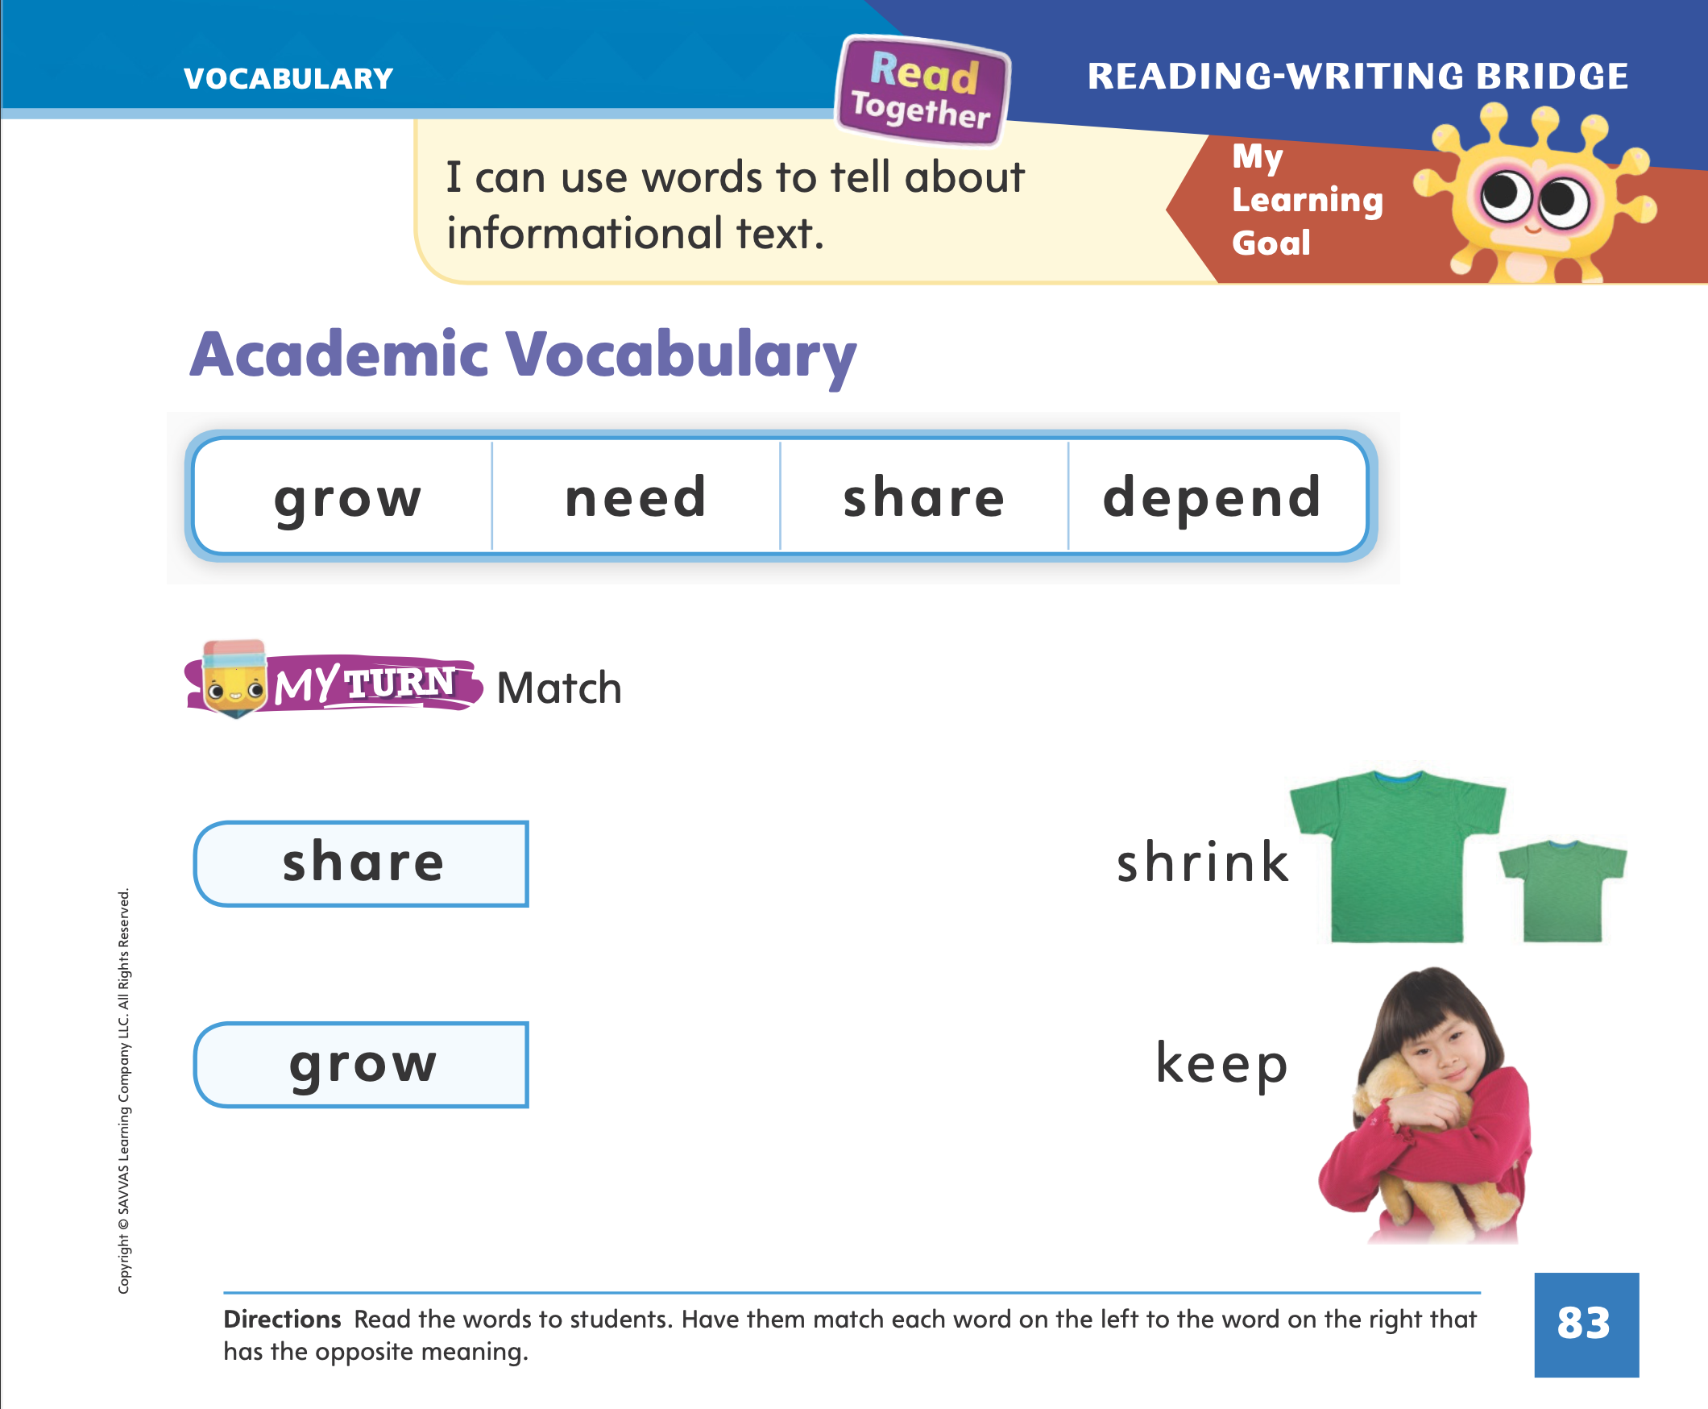
Page 83
Academic Vocabulary
Turn to page 83 in your Student Interactive and complete the activity.
Notes:
Explain to students that antonyms are words with opposite meanings. They can use these strategies to decide if two words are antonyms.
Say the first word. What does it mean?
Say the second word. What does it mean?
Do the two words have opposite meanings? If so, they are antonyms, or opposites.
Read the words in the right-hand column of p. 83 in the Student Interactive. Guide students to understand that shrink is the opposite of grow, and keep is the opposite of share.
Hold up your hand and tell students that adults have big hands. What word describes the size of an adult’s hand? Yes, big. Now picture a baby’s hand. A baby’s hand is little. Because big and little are opposites, they are antonyms.
Provide additional example words, such as up, open, empty, and dry. Guide students to name an antonym for each word. (Possible responses: down, close, full, wet)
Have students complete the activity on p. 83 in the Student Interactive.

Slide 13
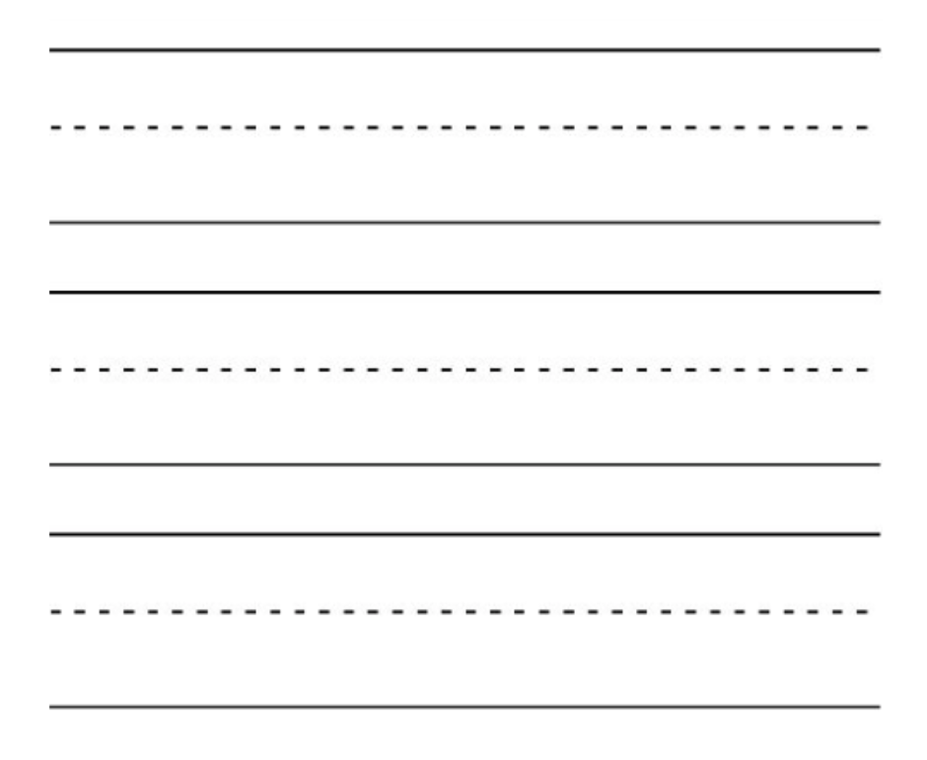


Handwriting
Notes:
Display the following uppercase and lowercase letters: Cc.
Model how to write the uppercase letter C. Show students how the letter is formed by starting near the top right and curving around to the left. Have them practice forming the letter in the air with their finger. Then repeat with the lowercase letter c.
Have students use Handwriting, p. 78 in the Resource Download Center to practice writing Cc. Click path: Realize -> Table of Contents -> Resource Download Center -> Handwriting Practice -> U2W2L1 Handwriting Practice

Slide 14
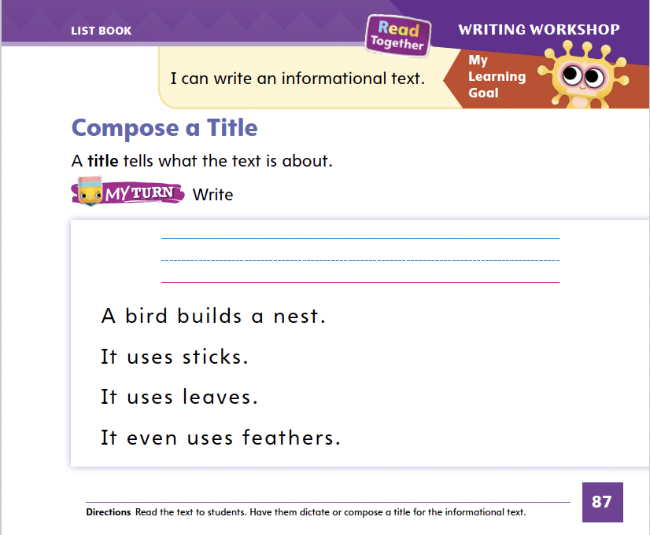
Page 87
Writing – List Book
Turn to page 87 in your Student Interactive and complete the activity.
Notes:
An author gives a name to his or her book, and that is called the title. The title tells what the book will be about.
Display the front cover of a book from your stack. Remind students that an author wrote this book, and the author chose the title. Read the title aloud and discuss with students what they think the book will be about.
Pull another book from your stack, without showing the title to students. Read a few details from the book aloud, and display the image on the front cover. Ask students what a good title for this book might be. Then reveal the title and ask students how it compares to their title ideas.
Have students turn to p. 87 in the Student Interactive. Now you will think of a title for this text. Read the text together and ask students what it is about. Then have students name possible titles as you write them on the board. Ask students to compose an informational text by copying a title onto p. 87.

Slide 15

Independent Writing
Write a title for your book.
Notes:
Tell students to use some of their independent writing time to think of a title for their book.
WRITING SUPPORT
Modeled Choose a stack text and do a Think Aloud to model how to come up with a title.
Shared Have students choose a stack text. Prompt students to tell how the title helps you understand the main idea of the text.
Guided Use the stack texts to provide explicit instruction on how to identify the main idea and details from the title. (Intervention Refer to the Small Group Guide for support.)
If students have decided on a title, have them continue writing their list book.
As students write, use the conference prompts in the Teacher’s Edition or Resource Download Center to provide support. Click path: Table of Contents -> Resource Download Center -> Writing Workshop Conference Notes
When you bring the class back together, call on students with whom you conferred today, and ask them to share their titles. Ask the class what they think each student’s book will be about.

Slide 16
Language and Conventions
  I have a ______ book.
  I have a ______ flower.
Complete the sentences with adjectives.
Notes:
Review with students that adjectives describe people, places, animals, and things. Invite volunteers to list examples of adjectives and write them on the board.
Display this sentence frame for students: I have a ____ book. Ask students to name adjectives that could describe the book. Rewrite the sentence with the different adjectives.
Have students work with a partner to complete the following sentence frame: I have a _____ flower.

Slide 17
Lesson 2

Slide 18

Phonics
box
Notes:
Hold up Picture Card box. This is a picture of a box. Listen to the sounds in box: /b/ /o/ /ks/. I hear the sound /o/ in the middle of box. Say the sound /o/ with me. Click path -> Table of Contents -> Unit 2 Week 2 Informational Text -> Lesson 2
Flip the card over and show students the spelling of the word. Read the word, pointing to each letter as you say the sound: /b/ /o/ /ks/. Do you hear the sound /o/? What letter spells the sound /o/? Have students identify the letter o. Let's trace the letter in the air. When we see this letter in a word, what sound will we say? (/o/)

Slide 19
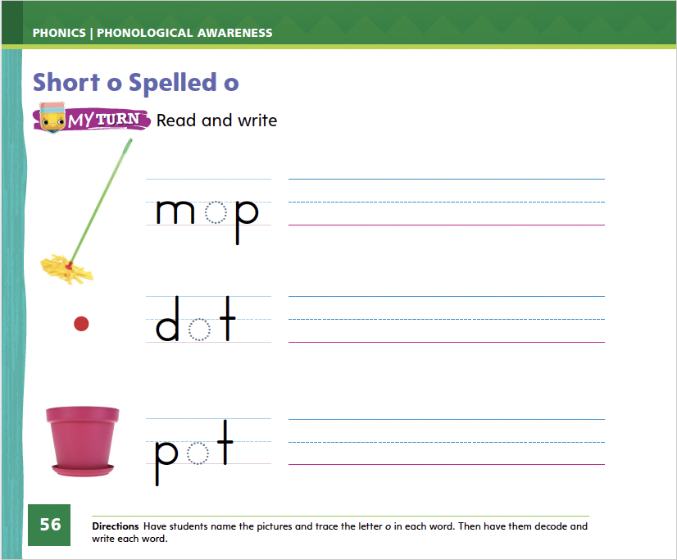
Page 56
Apply
Turn to page 56 in your Student Interactive and complete the activity.
Notes:
Have students turn to p. 56 in the Student Interactive. Help them name each picture. Let’s say the word and listen to the middle sound: /m/ /o/ /p/. The middle sound is /o/. What letter spells that sound? Have students trace the o on the line. Repeat for the words dot and pot.
Have students complete p. 56 in the Student Interactive. They should decode and write each CVC word.

Slide 20
High-Frequency Words
they
you
do
Notes:
Tell students that high-frequency words are words that they will hear and see over and over in texts. Write and read the words do, you, and they.
Have students
read the words with you.
spell each word, clapping as they say each letter.

Slide 21
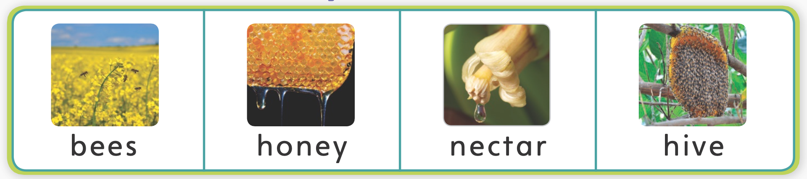
Page 68
Preview Vocabulary
Notes:
Introduce the words bees, honey, nectar, and hive from p. 68 in the Student Interactive.
Have students share what they already know about the words. Ask questions such as:
What do you know about bees?
Have you ever eaten toast with honey?
Are you small enough to live in a hive?
Have students demonstrate what they know about the words. They can make buzzing noises like a bee. They can show how they feel about the taste of honey by pretending to taste some.
The words bees, honey, nectar, and hive will help us understand the text From Nectar to Honey.

Slide 22
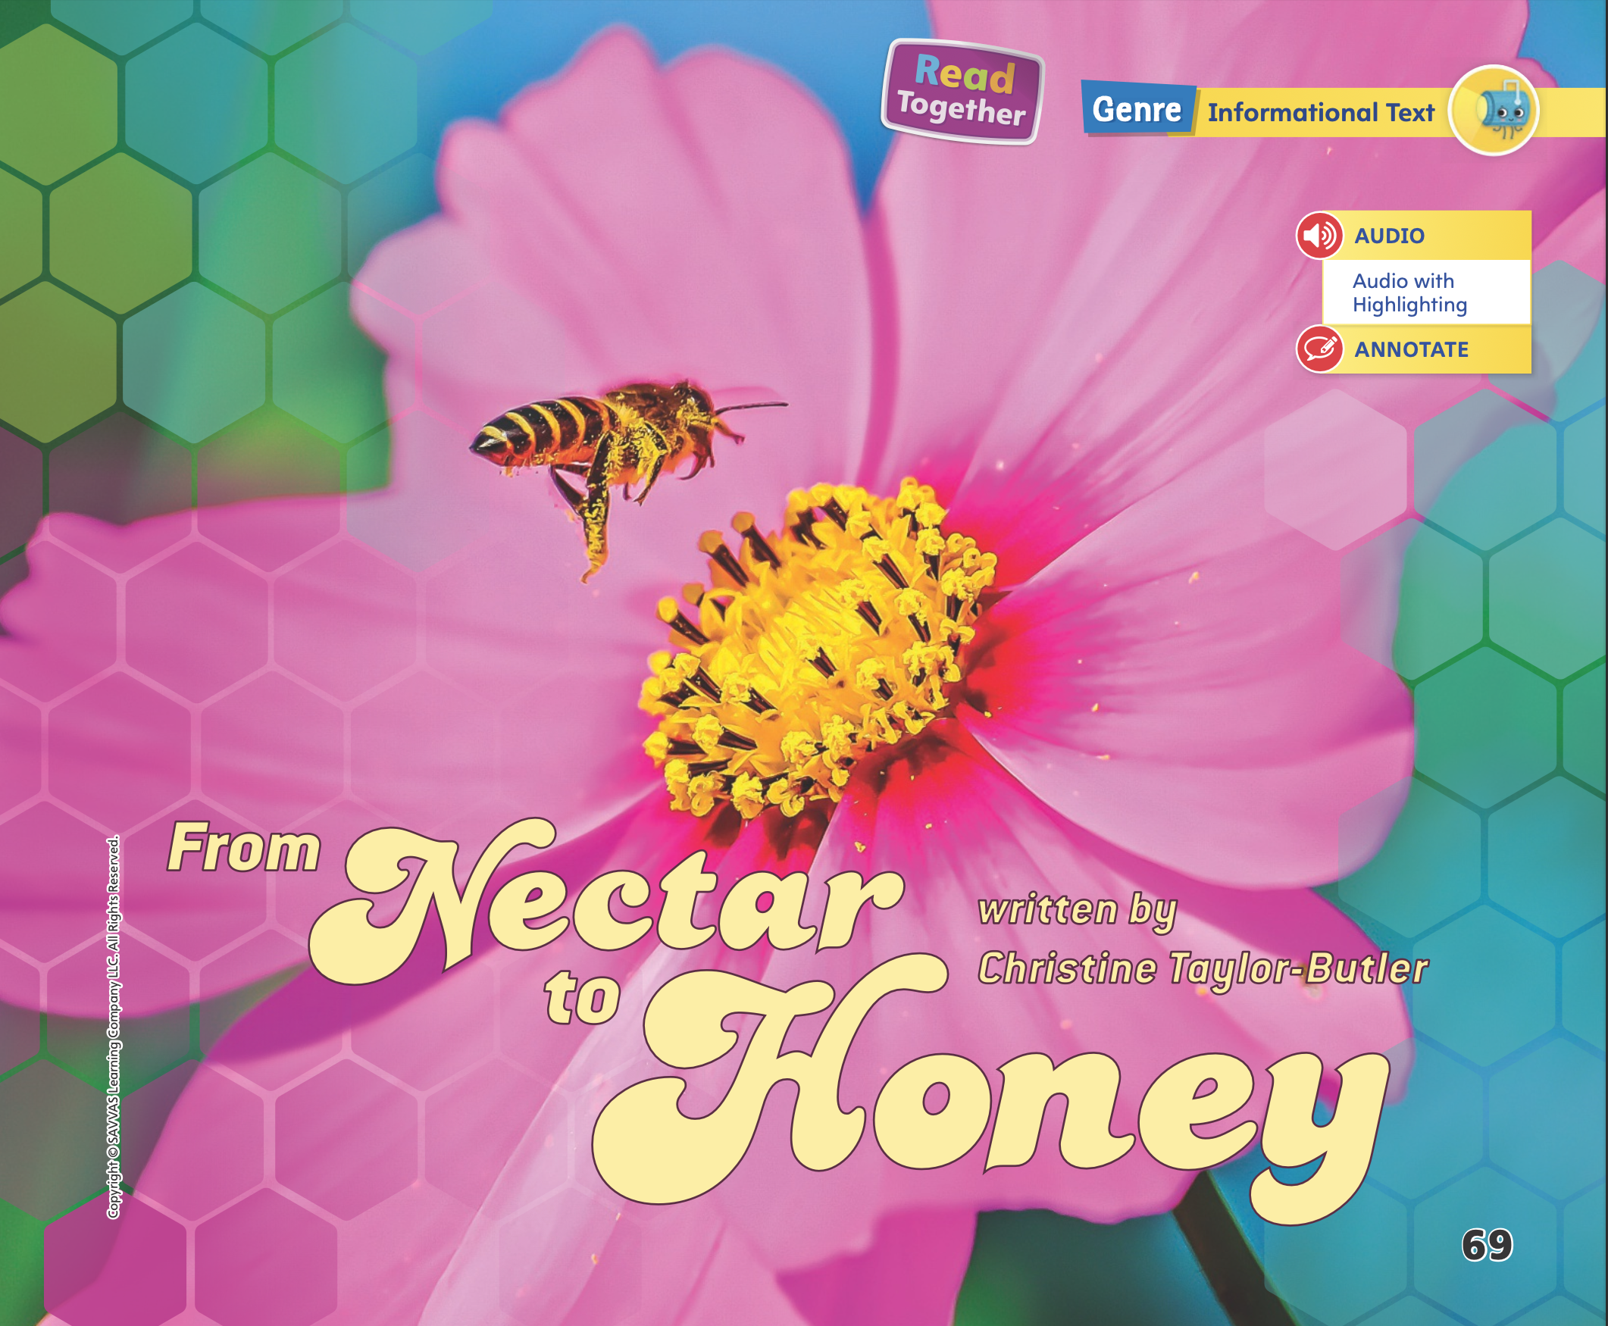
Page 69
First Read Strategies
Notes:
Discuss the First Read Strategies with students. Tell students that looking at the title and pictures before reading can help them figure out what the text will be about. Say: Listen to the title and look at the picture. What questions do you have before you read the text?
Explain that if students don’t understand something, they can make adjustments by rereading, using background knowledge, or asking questions. Have students monitor their comprehension as they read. If students’ understanding of the text breaks down, prompt them to make adjustments by asking questions and rereading to find the answers to their questions. These answers will provide students new information and a better understanding of the reading. Provide assistance as necessary.
Listen and read along, tracking the print, as the text is read aloud.
Look at the pictures to help understand the text.
Generate, or ask, questions about the text to deepen understanding.
Talk to a partner about the text.
Students may read the text independently, in pairs, or as a whole class. Use the First Read notes to help students connect with the text and guide their understanding.

Slide 23
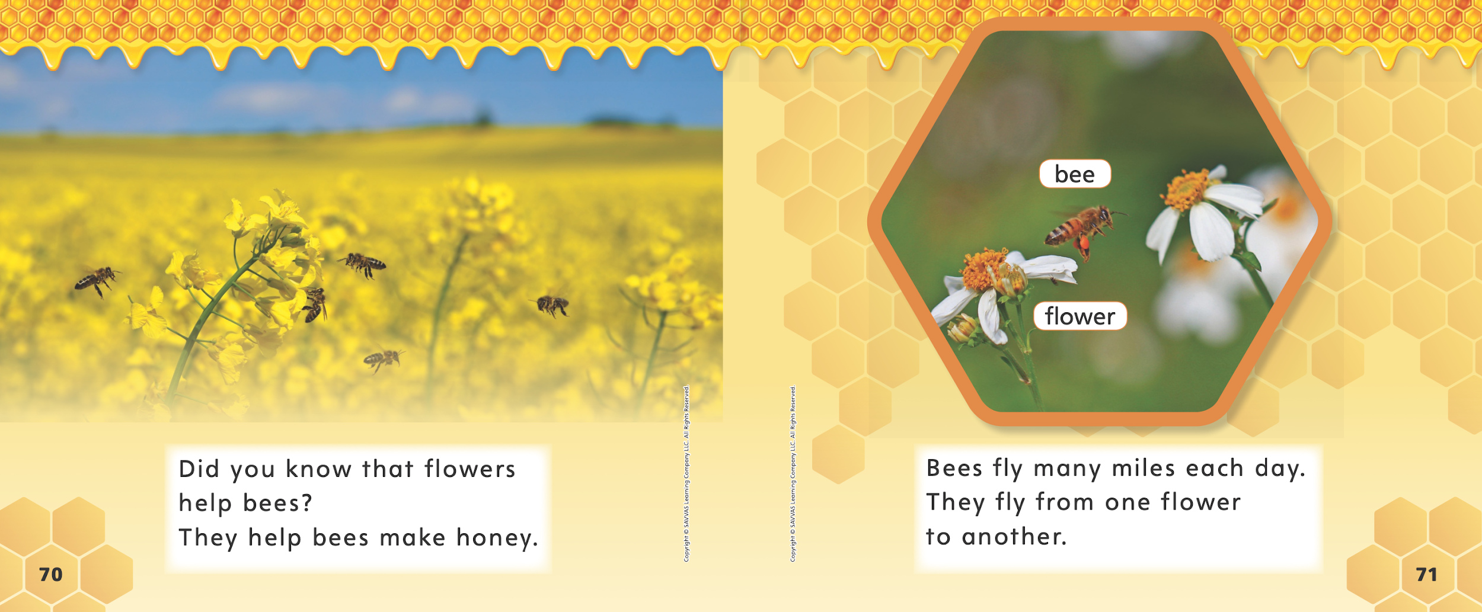

Page 70, 71
First Read – From Nectar to Honey
Notes:
Look together at the text.
THINK ALOUD: I don’t understand why bees fly from one flower to another. When I don’t understand something in a text, I can ask a question about it. Then I can go back and reread the text to find the answer. My question is, Why do bees fly from one flower to another? I will reread these pages. The sentences on page 70 tell me that flowers help bees make honey. Now I understand why bees fly from flower to flower!

Slide 24
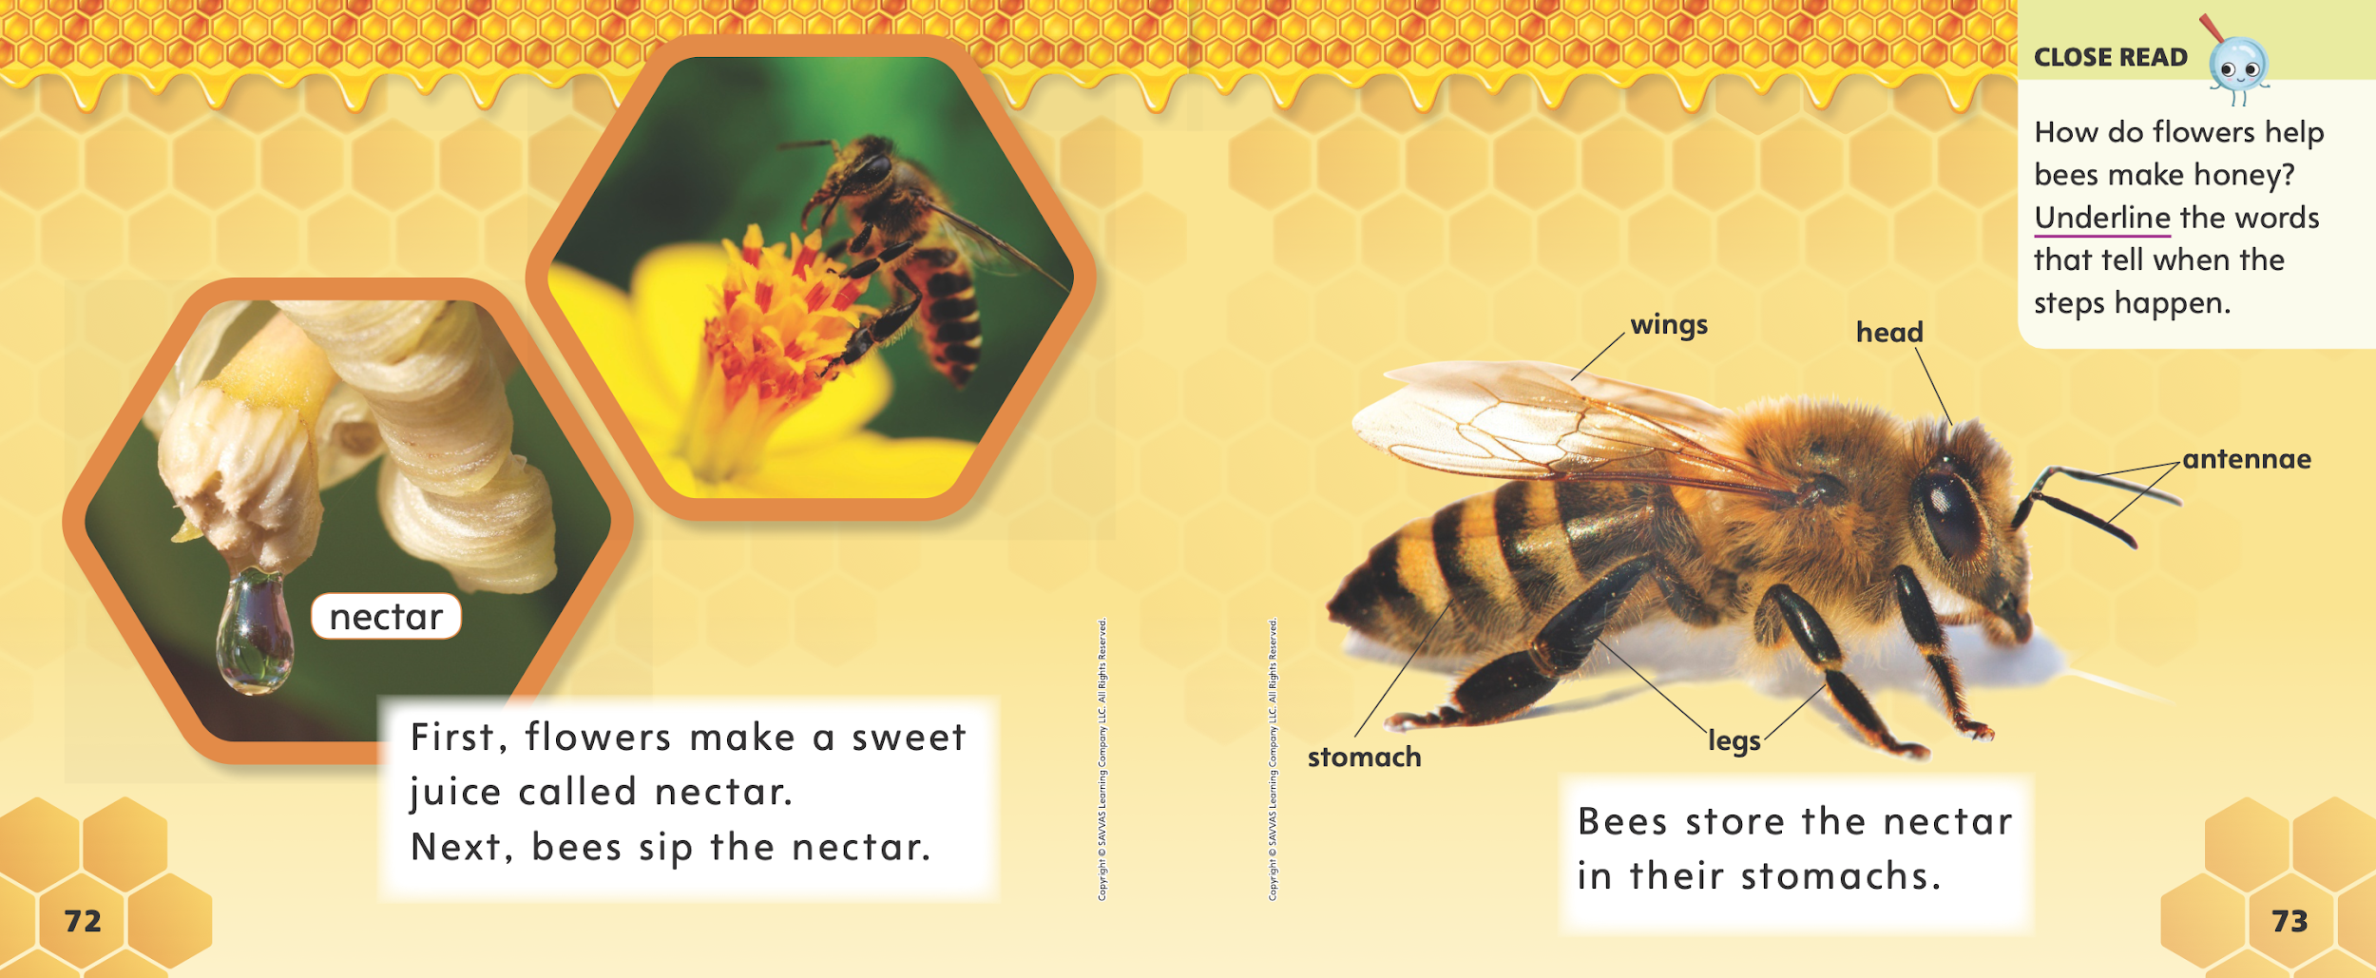
Page 72, 73
First Read – From Nectar to Honey
Notes:
Read Together.

Slide 25
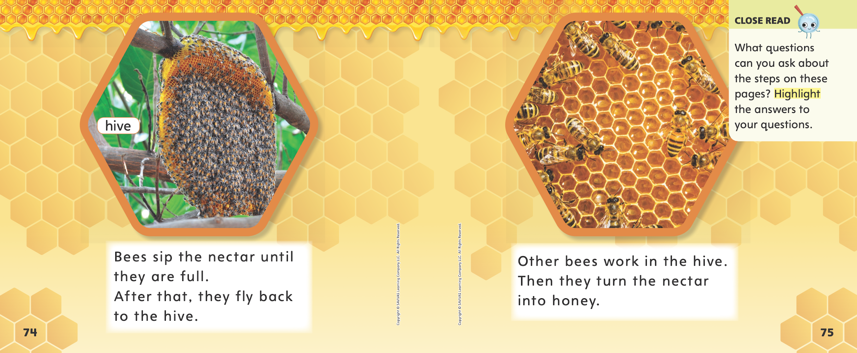
Page 74, 75
First Read – From Nectar to Honey
Notes:
Read Together.
The text says that when bees are full from sipping nectar, they fly back to the hive. Then the text says that bees work in the hive. I wonder what a hive is? I can see from the photographs that there are many bees in one place, turning nectar into honey. I am going to talk to a partner to see what he or she thinks a hive is. I bet it is the bees' home. I will tell that to my partner.

Slide 26
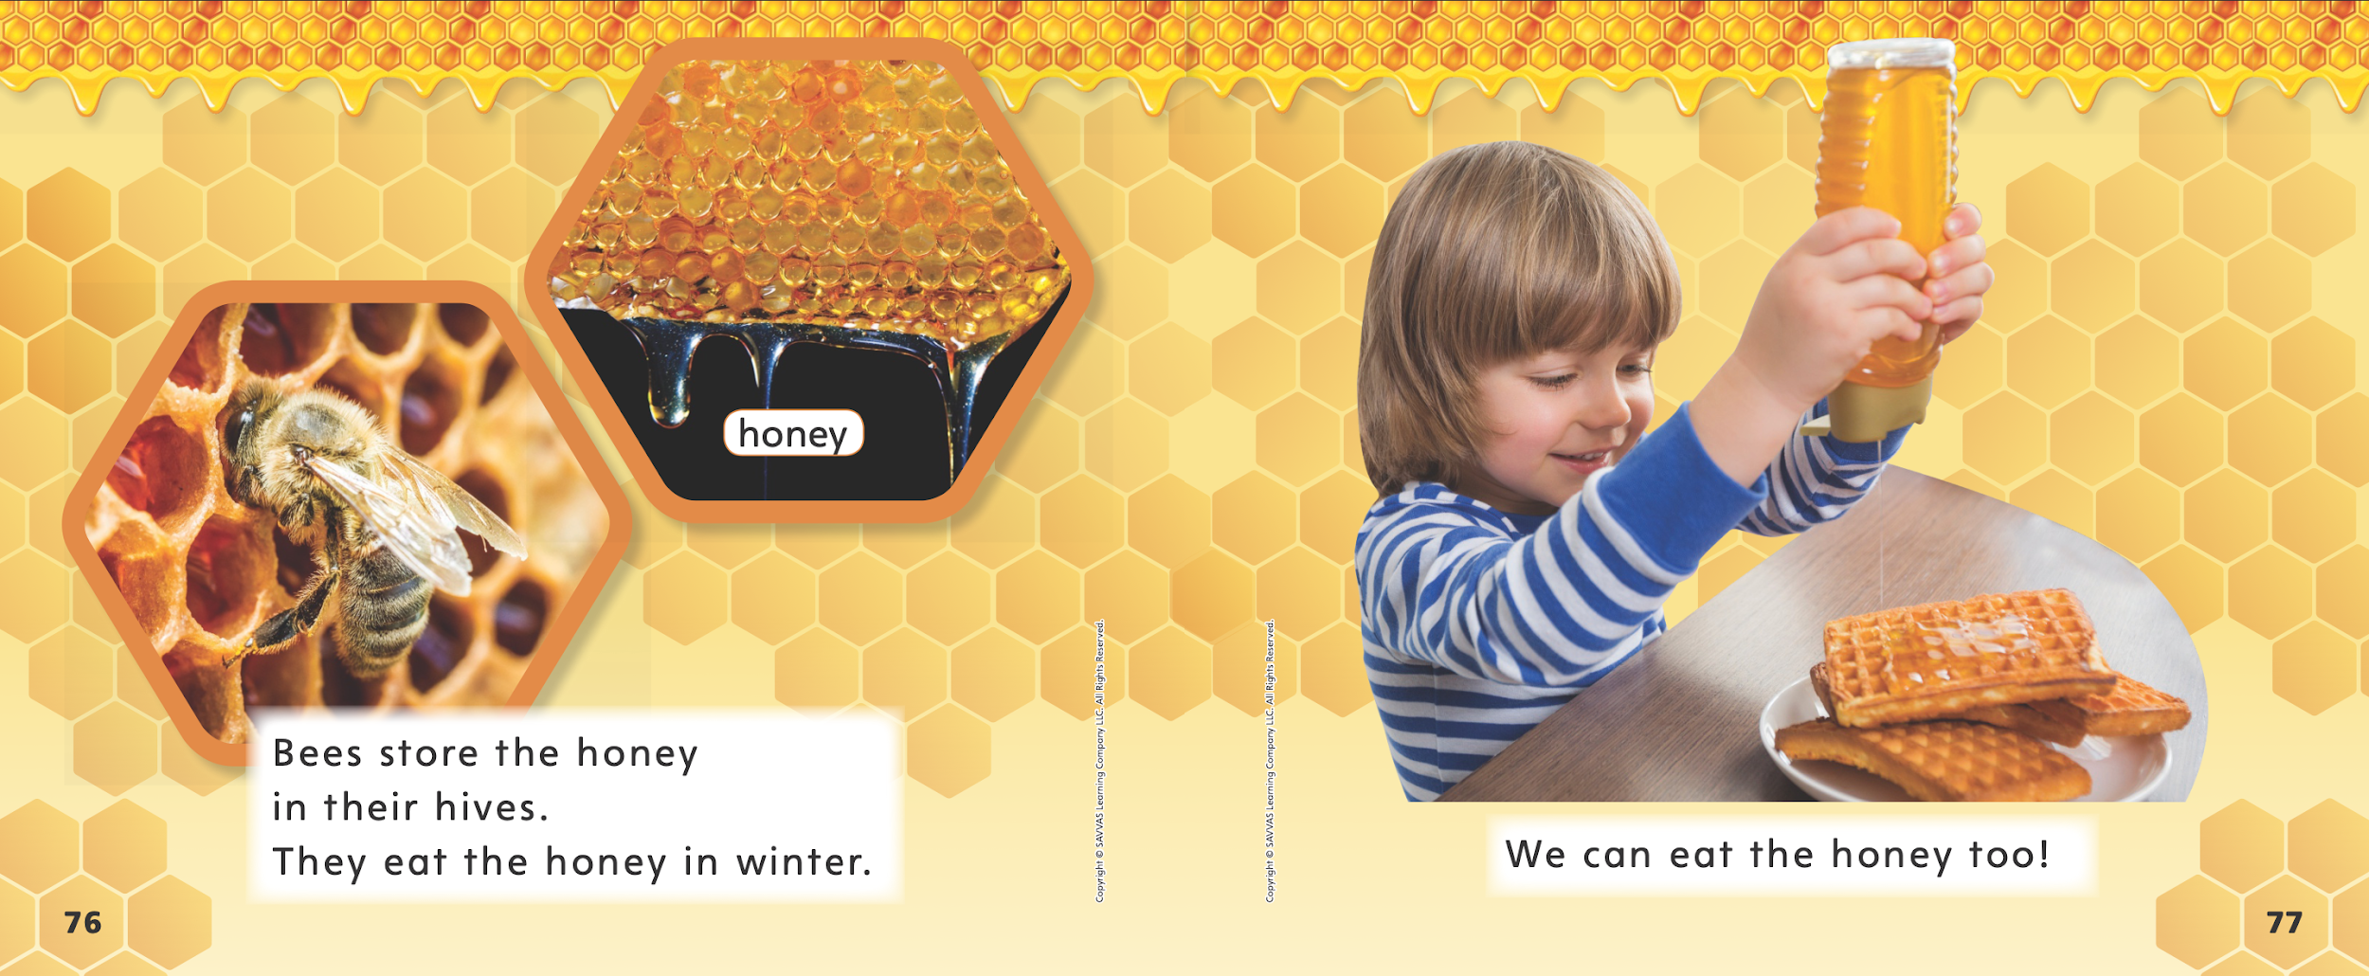
Page 76, 77
First Read – From Nectar to Honey
Notes:
Read Together.

Slide 27
Respond and Analyze
Retell Tell a partner about the part of the text that was most interesting to you.
Illustrate Draw a picture of a bee and illustrate the parts of the bee’s body.
Notes:
Use these suggestions to prompt students’ initial responses to reading From Nectar to Honey.
Retell Have students tell a partner about the part of the text that interested them the most and ask what he or she found the most interesting. Ask: What part interested you the most? Why?
Illustrate Details Have students draw a picture of a bee and illustrate the parts of the bee’s body. Then have partners tell details about each part and discuss how these parts help the bee make honey. Ask: How does each part of the bee’s body help it do its job of making honey?

Slide 28
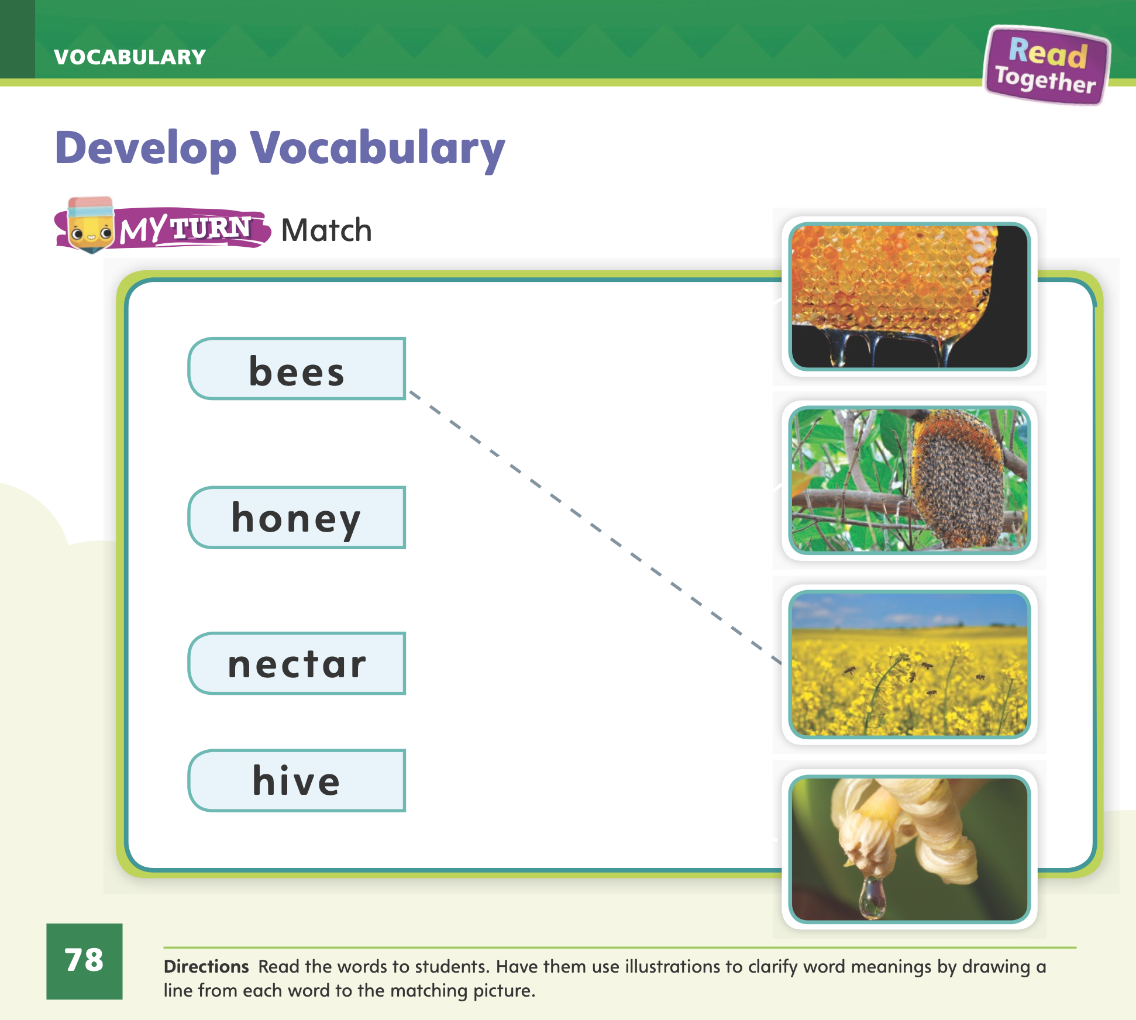
Page 72, 78
Develop Vocabulary
Turn to page 78 in your Student Interactive and complete the activity.
Notes:
Tell students that authors choose words carefully. The vocabulary words bees, honey, nectar, and hive can be used to talk about the main idea in From Nectar to Honey. Have students turn to pp. 72–73 in the Student Interactive. Use the word nectar to model the strategy.
Read the word and the sentences in which it is used.
Look for photographs or illustrations that help you picture and understand the word.
Think about why the author needed to use this word. What information is the author trying to give the reader?
Have students turn to p. 78 in the Student Interactive. Model how to complete the activity using the word bees. Read the directions aloud and ask students to look at the pictures. Ask: Which is the picture of bees?

Slide 29
Page 79
Check for Understanding
What is the main idea?
Why does the author use the words first and next?
Why do bees need to fly many miles each day?
Notes:
Have students complete the Check for Understanding on p. 79 in the Student Interactive.

Slide 30
Writing – List Book
Name the main idea and explain how you know.
Notes:
The main idea is the most important thing the author wants to tell the reader. The main idea is important because it tells the reader what the book will be about.
Display a book from your stack. Page through the book and tell students what you see.
Point out the title.
Read the first sentence.
Read the headings on the pages.
Explain what you see in the pictures.
Once you have paged through the text, identify the main idea. Write the main idea on the board.
Display another book from your stack and page through it. This time, allow students to talk about what they notice. Have them name the main idea and ask them how they know. Continue with additional stack texts until students show understanding.

Slide 31
Independent Writing
Decide on a main idea for your book by thinking about the most important thing you want to share with readers.
Notes:
As students enter into their independent writing time, tell them to decide on the main idea for their book by thinking about the most important thing they want to share with readers.
WRITING SUPPORT
Modeled Use a stack text and do a Think Aloud to identify the main idea of a text.
Shared Prompt students to identify the main idea and details by looking at the pictures.
Guided Use the stack texts to provide explicit instruction on identifying the main idea.
If students have determined their main idea, have them use this time to continue writing their list book.
As students write, use the conference prompts in the Teacher’s Edition or Resource Download Center to provide support. Click path: Table of Contents -> Resource Download Center -> Writing Workshop Conference Notes
After independent writing time, choose two students to share the main ideas of their books. Ask them to share their process for deciding on their main ideas.

Slide 32
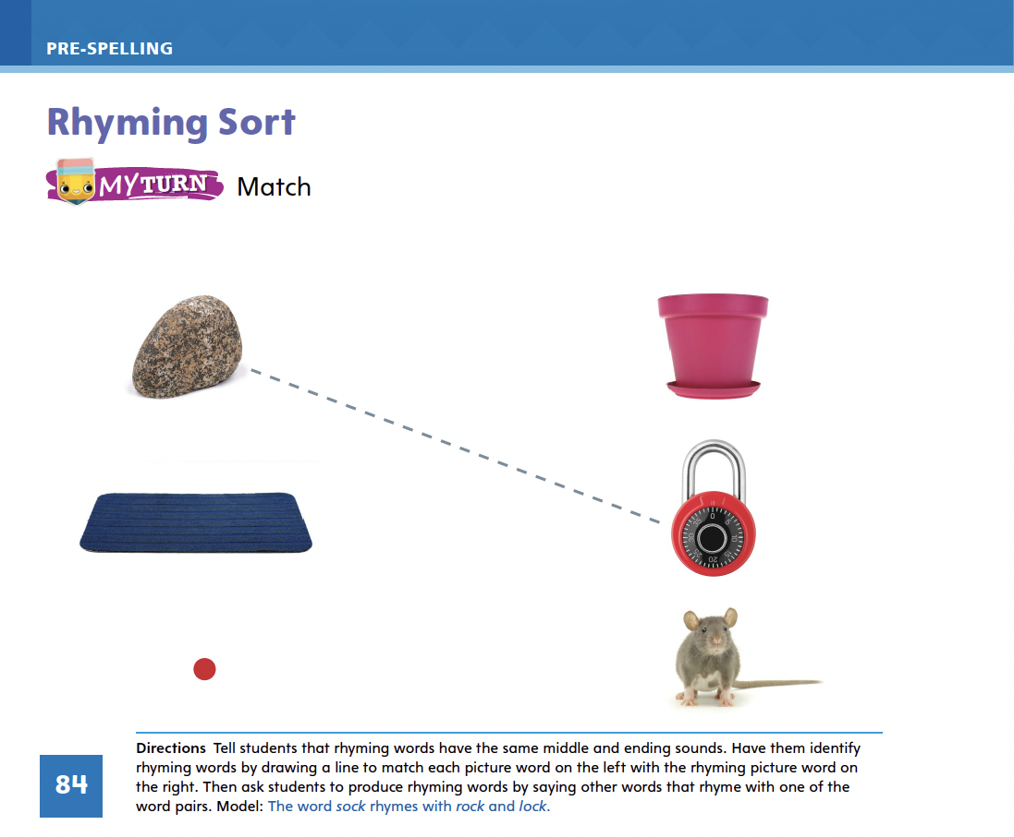
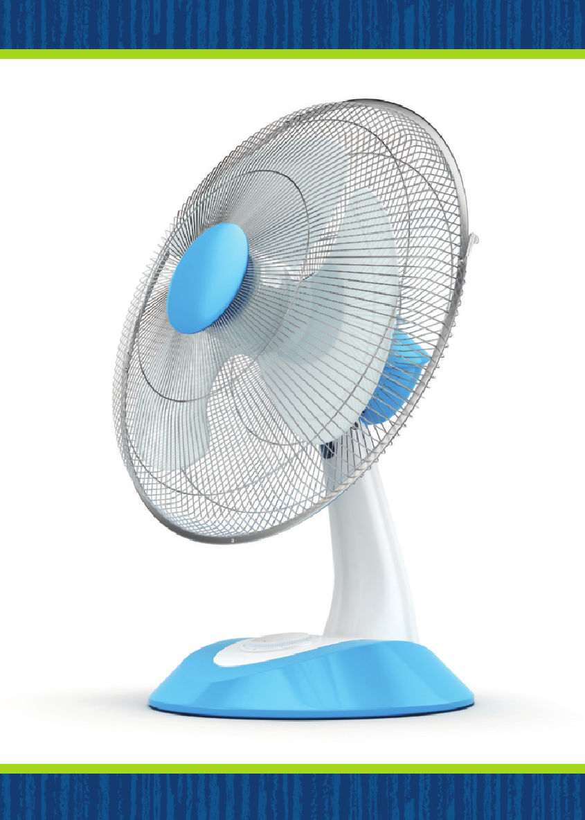
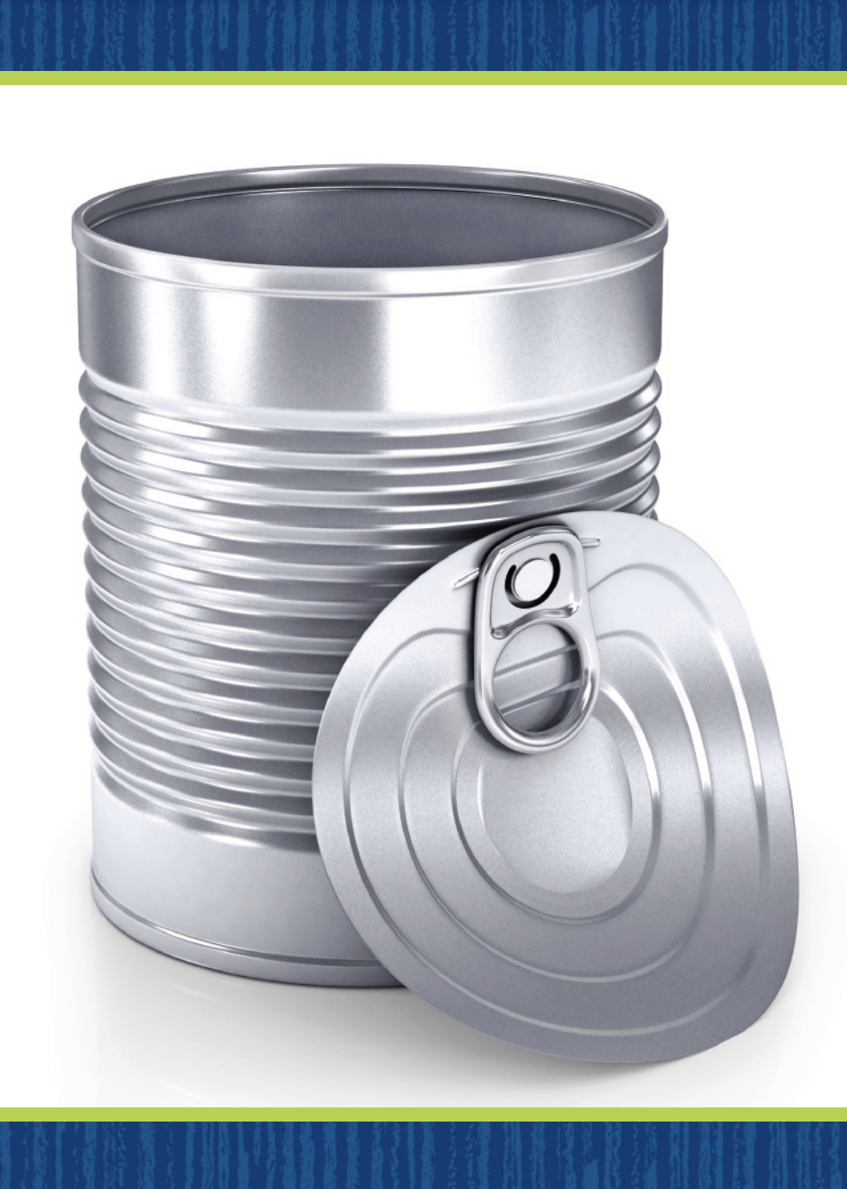
Page 84
Rhyming Sort
Turn to page 84 in your Student Interactive.
Notes:
Remind students that rhyming words end with the same sounds but have different beginning sounds. Display the can and fan Picture Cards. Have students produce rhyming words by naming the pictures on the cards. Tell students that can and fan are rhyming words. Click path -> Table of Contents -> Unit 2 Week 2 Informational Text -> Lesson 2
Have students identify the initial and ending sounds in can. Listen to the word can. What is the first sound in can? That’s right. The first sound in can is /k/. How does can end? That’s right, can ends with the sounds /a/ /n/. Continue with fan.
Ask what makes can and fan rhyming words. Lead students to conclude that can and fan end with the same sounds and that is why they rhyme. Have students turn to p. 84 in the Student Interactive. Emphasize rock in the following sentence: I see a rock. Point to the rock. Circulate to be sure that students have identified the rock. The word rock ends with the sounds /o/ /k/. Which picture on the other side of the page also ends with the sounds /o/ /k/? I see a lock. The word lock also ends with /o/ /k/, so the words rock and lock rhyme. Have students draw a line between the two pictures.
Have students identify the other rhyming pairs on p. 84 of the Student Interactive. Give help as needed or work through the activity together to help students find and produce rhyming words.

Slide 33
Language and Conventions
  This is a new book.
  This is the new book that my mom gave me.
Work in pairs to create oral sentences with one noun, an adjective and an article.
Notes:
Answer any questions students may have about adjectives. Then introduce that a, an, and the are articles, which are a type of adjective. Explain that a and an are used with a singular noun when not naming a certain one. The article the is used with a specific singular noun. Share sentences containing articles and adjectives with students.
\Display this sentence: This is a new book. Ask: Which word is a noun? (book) Which word is an adjective that describes the book? (new) Which word is an article that tells about the book?
(a) Repeat with the sentence: This is the new book that my mom gave me. Point out that this sentence talks about a specific book. It needs the article the.
APPLY Have students work in pairs to create oral sentences containing one noun, an adjective, and an article. Have students share their sentences with the class, identifying the noun, adjective, and article.

Slide 34
Lesson 3

Slide 35
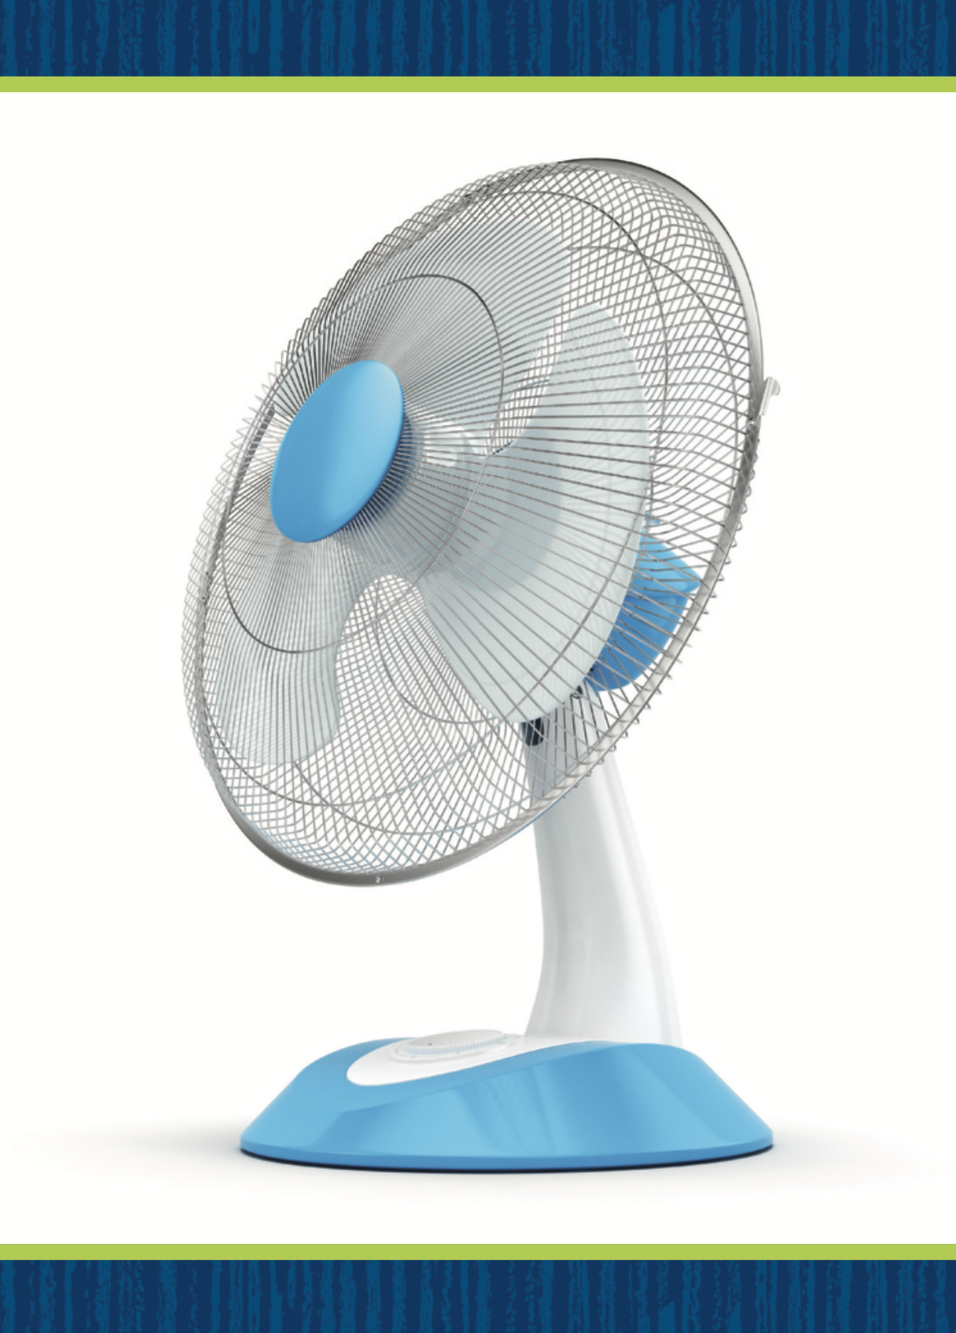
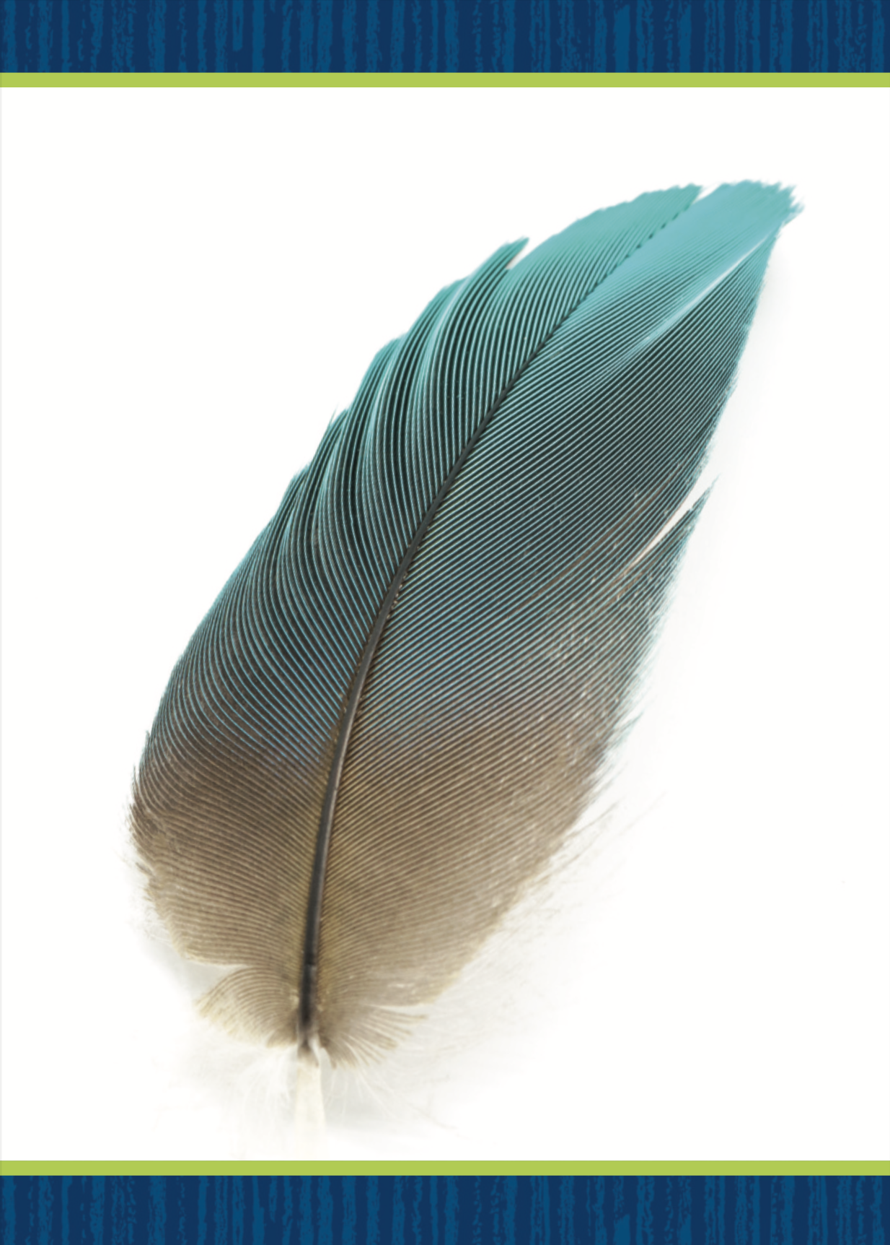

Page 57
Phonological Awareness
Notes:
Today we will practice using alliteration. Alliteration is when a word begins with the same sound as many of the other words around it. If I say Frank finds football fun, all the words begin with the same sound. What sound is that? Yes, /f/. Have students repeat the sentence after you.
Display the fan, feather, and five Picture Cards. Say: These three words all begin with the same sound: /f/. What is the word we say when words all begin with the same sound? Students should identify alliteration. What sound do you hear at the beginning of fan, feather, and five? (/f/) Tell students that you will say groups of words. Ask them to touch their toes if all of the words begin with the same sound: fire, fell, fall; paste, follow, dot; fin, fish, far. Click path -> Table of Contents -> Unit 2 Week 2 Informational Text -> Lesson 3

Slide 36
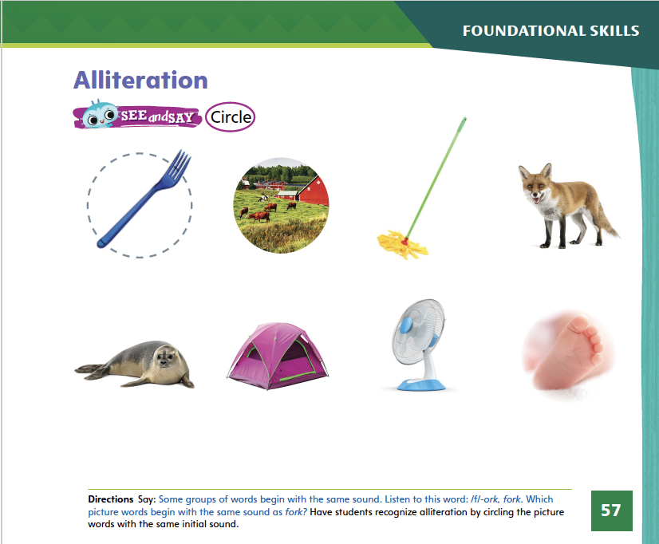
Page 57
Phonological Awareness
Turn to page 57 in your Student Interactive and complete the activity.
Notes:
Point to the picture of the fork on p. 57 of the Student Interactive. Fork has the sound /f/ at the beginning. Have students circle the pictures of all the words that begin with the same initial sound as fork.

Slide 37
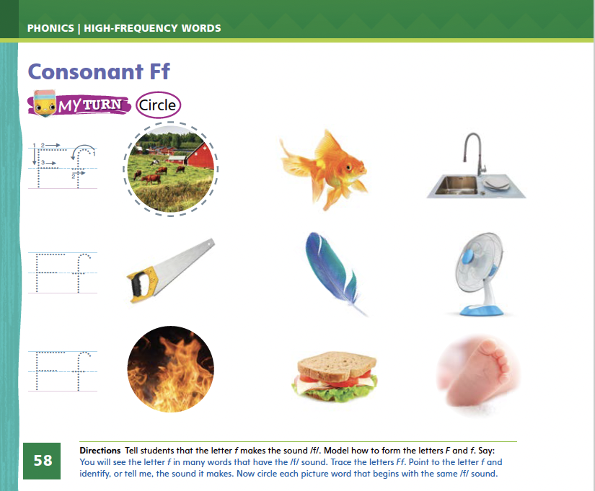

Page 58
Phonics
Turn to page 58 in your Student Interactive and complete the activity.
Notes:
Tell students that the sound /f/ is spelled with the letter f. Display Alphabet Card Ff. Point to the picture of the fountain and tell students that the word fountain begins with f. Point to the letters on the card, and tell students that the names of these letters are uppercase F and lowercase f. Write uppercase and lowercase Ff on the board. Trace the letters slowly as you say the sound /f/.Click path -> Table of Contents -> Unit 2 Week 2 Informational Text -> Lesson 3
Have students turn to p. 58 in the Student Interactive. Let's say the picture word farm and listen to the beginning sound: /f/ -arm. The word begins with /f/. Can you identify, or tell me, what letter makes the sound /f/? Students should trace the uppercase and lowercase letters on the page.
Have them point to the letter f and identify, or tell you, what sound it represents.
Have students complete the activity on p. 58.

Slide 38
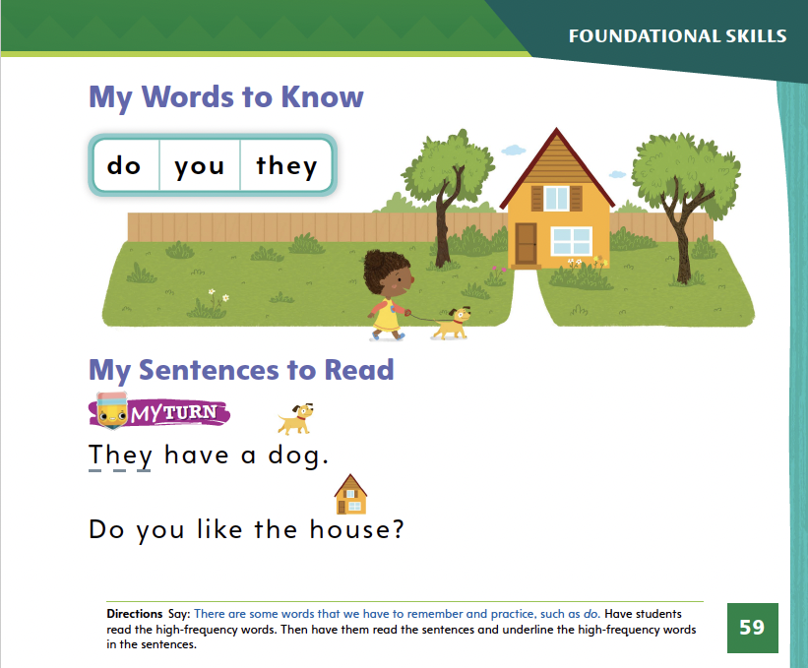
Page 59
High-Frequency Words
Turn to page 59 in your Student Interactive.
Notes:
Say: Today we will practice reading the high-frequency words do, you, and they. Have students read the words at the top of p. 59 in the Student Interactive with you: do, you, they.
Have students look at the words at the top of p. 59. Say: I will read a word, and I want you to point to it. Then we will read the word together.
Read do, and have students point to it. Now let’s read the word together: do. Repeat with the other words.
Have students read the sentences on p. 59 with you. Ask them to identify and underline the words they, you, and do in the sentences. Then have them read the sentences with a partner.

Slide 39
Page 69
Close Read – Find Text Structure
Notes:
Text structure is how a text is put together. Some informational texts tell the steps in a sequence, or what comes first, next, and last.
Read the text. Can you find any sequence words, such as first, next, last?
Look at the sequence words. How do they help you understand what happens when in the text?
Have students look at From Nectar to Honey in the Student Interactive. Point out that the text shows a series of steps.
What happens first?
What happens next?
What happens last?
Guide students to form oral sentences using first, next, and last to explain the steps in the text. Have students turn to the Close Read note on p. 73 and underline the words that tell when steps happen.

Slide 40
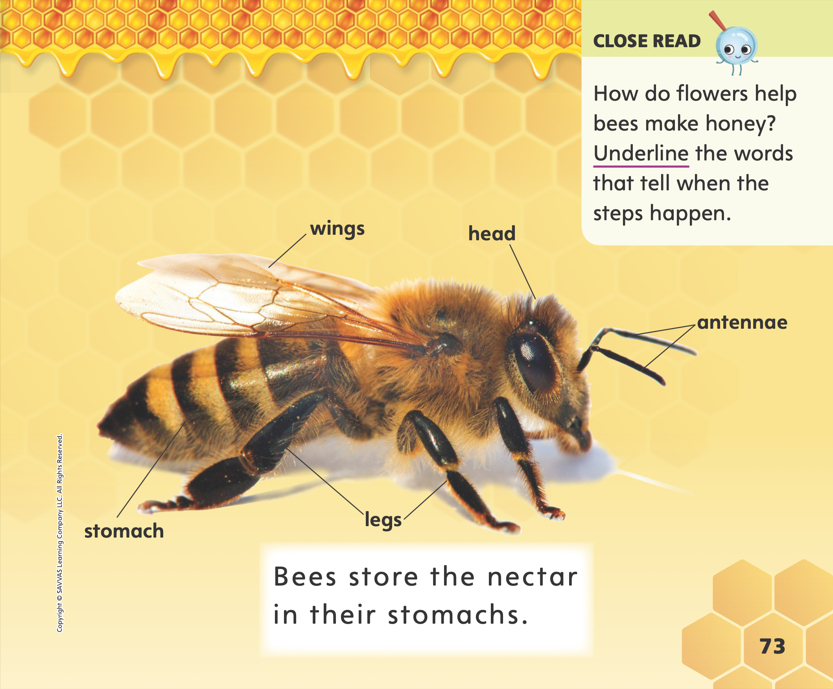
Page 73
Close Read – Find Text Structure
Turn to page 73 in your Student Interactive.
Notes:
Tell students that From Nectar to Honey shows steps in a sequence. Sometimes steps are numbered. Sometimes words tell the order in which things happen. Read aloud the Close Read note on p. 73 of the Student Interactive. Prompt students to identify and underline the words that tell when each step happens in the honey-making process. DOK 2

Slide 41
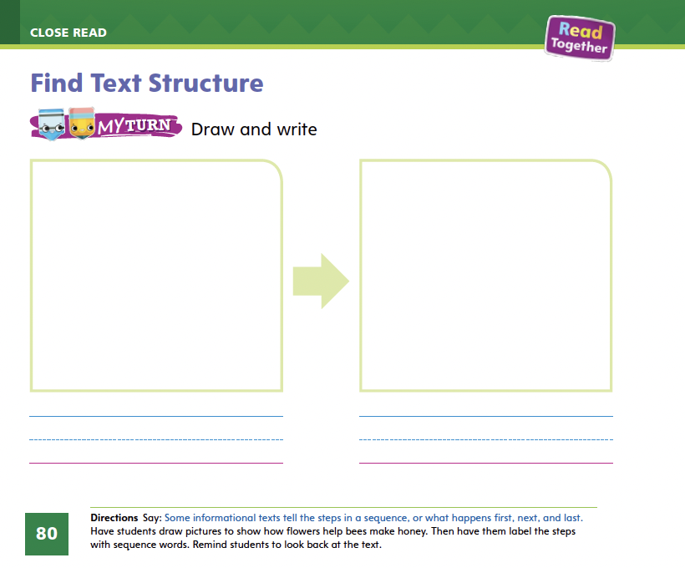
Page 80
Find Text Structure
Turn to page 80 in your Student Interactive and complete the activity.
Notes:
Have students use the strategies for finding text structure, specifically focusing on the sequence.
Have students complete p. 80 in the Student Interactive.

Slide 42
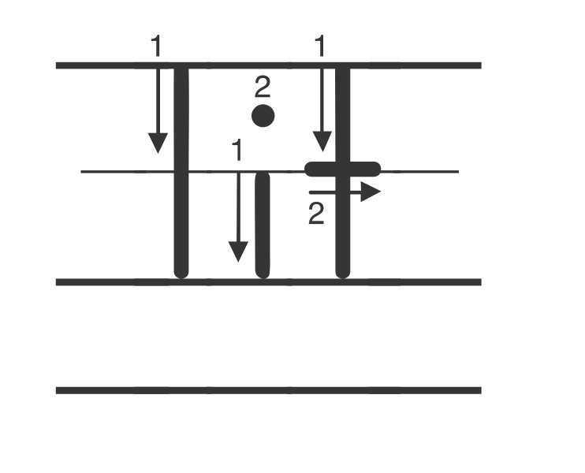
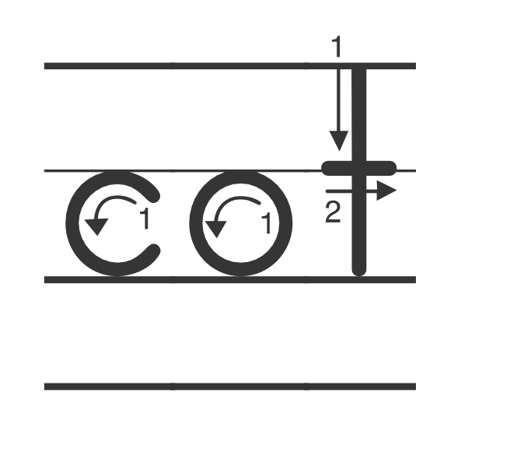
Handwriting
Notes:
Write these letters and have students identify each one: T, c, L, i, t, O, l, C, o, I.
Model writing the word lit. Tell students that each letter in a word needs to be formed correctly, with a small space between each letter.
Have students practice writing the word lit in the air, saying each letter as they write it. Then have them say the word. Repeat with the word cot.
Have students use Handwriting, p. 79 in the Resource Download Center to practice writing words moving left to right. Click path: Table of Contents > Resource Download Center > Handwriting Practice > U2W2L3 Handwriting Practice

Slide 43
Independent Writing
You will continue to work on your main idea for your book.
Notes:
As students enter into their independent writing time, remind them to continue working on the main idea for their books. Tell them that the reader should be able to easily identify the main idea.
WRITING SUPPORT:
Modeled Do a Think Aloud to model how to write a main idea for a list book about pets.
Shared Show a picture of people with different kinds of pets. Ask students to say a sentence that tells the main idea of the picture.
Guided Prompt students to think of a possible main idea for a list book about pets, such as kinds of pets or things pets need.
If some students have finalized their main idea, have them use this time to continue writing their list book.
As students write, use the conference prompts in the Teacher’s Edition or Resource Download Center to provide support. Click path: Table of Contents -> Resource Download Center -> Writing Workshop Conference Notes
Ask students to share their books’ main ideas. Invite the class to ask the students questions about their main ideas.

Slide 44
Language and Conventions
desk
board
book
chair
Notes:
Tell students that adjectives describe people, places, animals, and things.
Then tell students that the articles a, an, and the are types of adjectives that also give more information about nouns. The articles a and an are used with an unspecified singular noun. The article the is used with a singular noun when it is being specified.
To reinforce how to use adjectives and articles, name things in the classroom such as desk, board, book, and chair. Ask students to describe each thing using different articles and adjectives.

Slide 45
Lesson 4

Slide 46
Phonics
fan
fit
fin
Notes:
Hold up the Ff Alphabet Card. This is a picture of a fountain. It begins with the sound /f/. What letter spells the sound /f/? Point to the uppercase and lowercase letters and remind students that they are uppercase and lowercase Ff. Click path -> Table of Contents -> Unit 2 Week 2 Informational Text -> Lesson 4
Have several students name and write the letters on the board as the others write the letters in the air. Point to one of the letters on the board. When we see this letter, what sound will we say? (/f/)
Let's say the word and listen to the beginning sound: fan, /f/ /a/ /n/. The word begins with /f/, so it begins with the letter f. Now let's trace the letter f on the lines with our pencil.

Slide 47
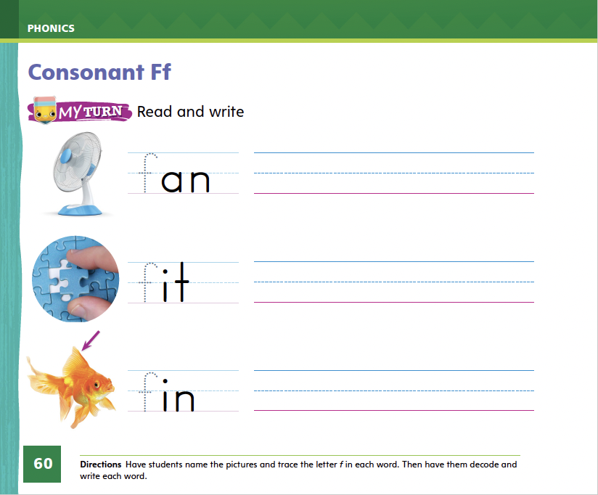
Page 60
Apply
Turn to page 60 in your Student Interactive and complete the activity.
Notes:
Have students turn to p. 60 in the Student Interactive. Help them name each picture Repeat the routine for the CVC words fit and fin.

Slide 48
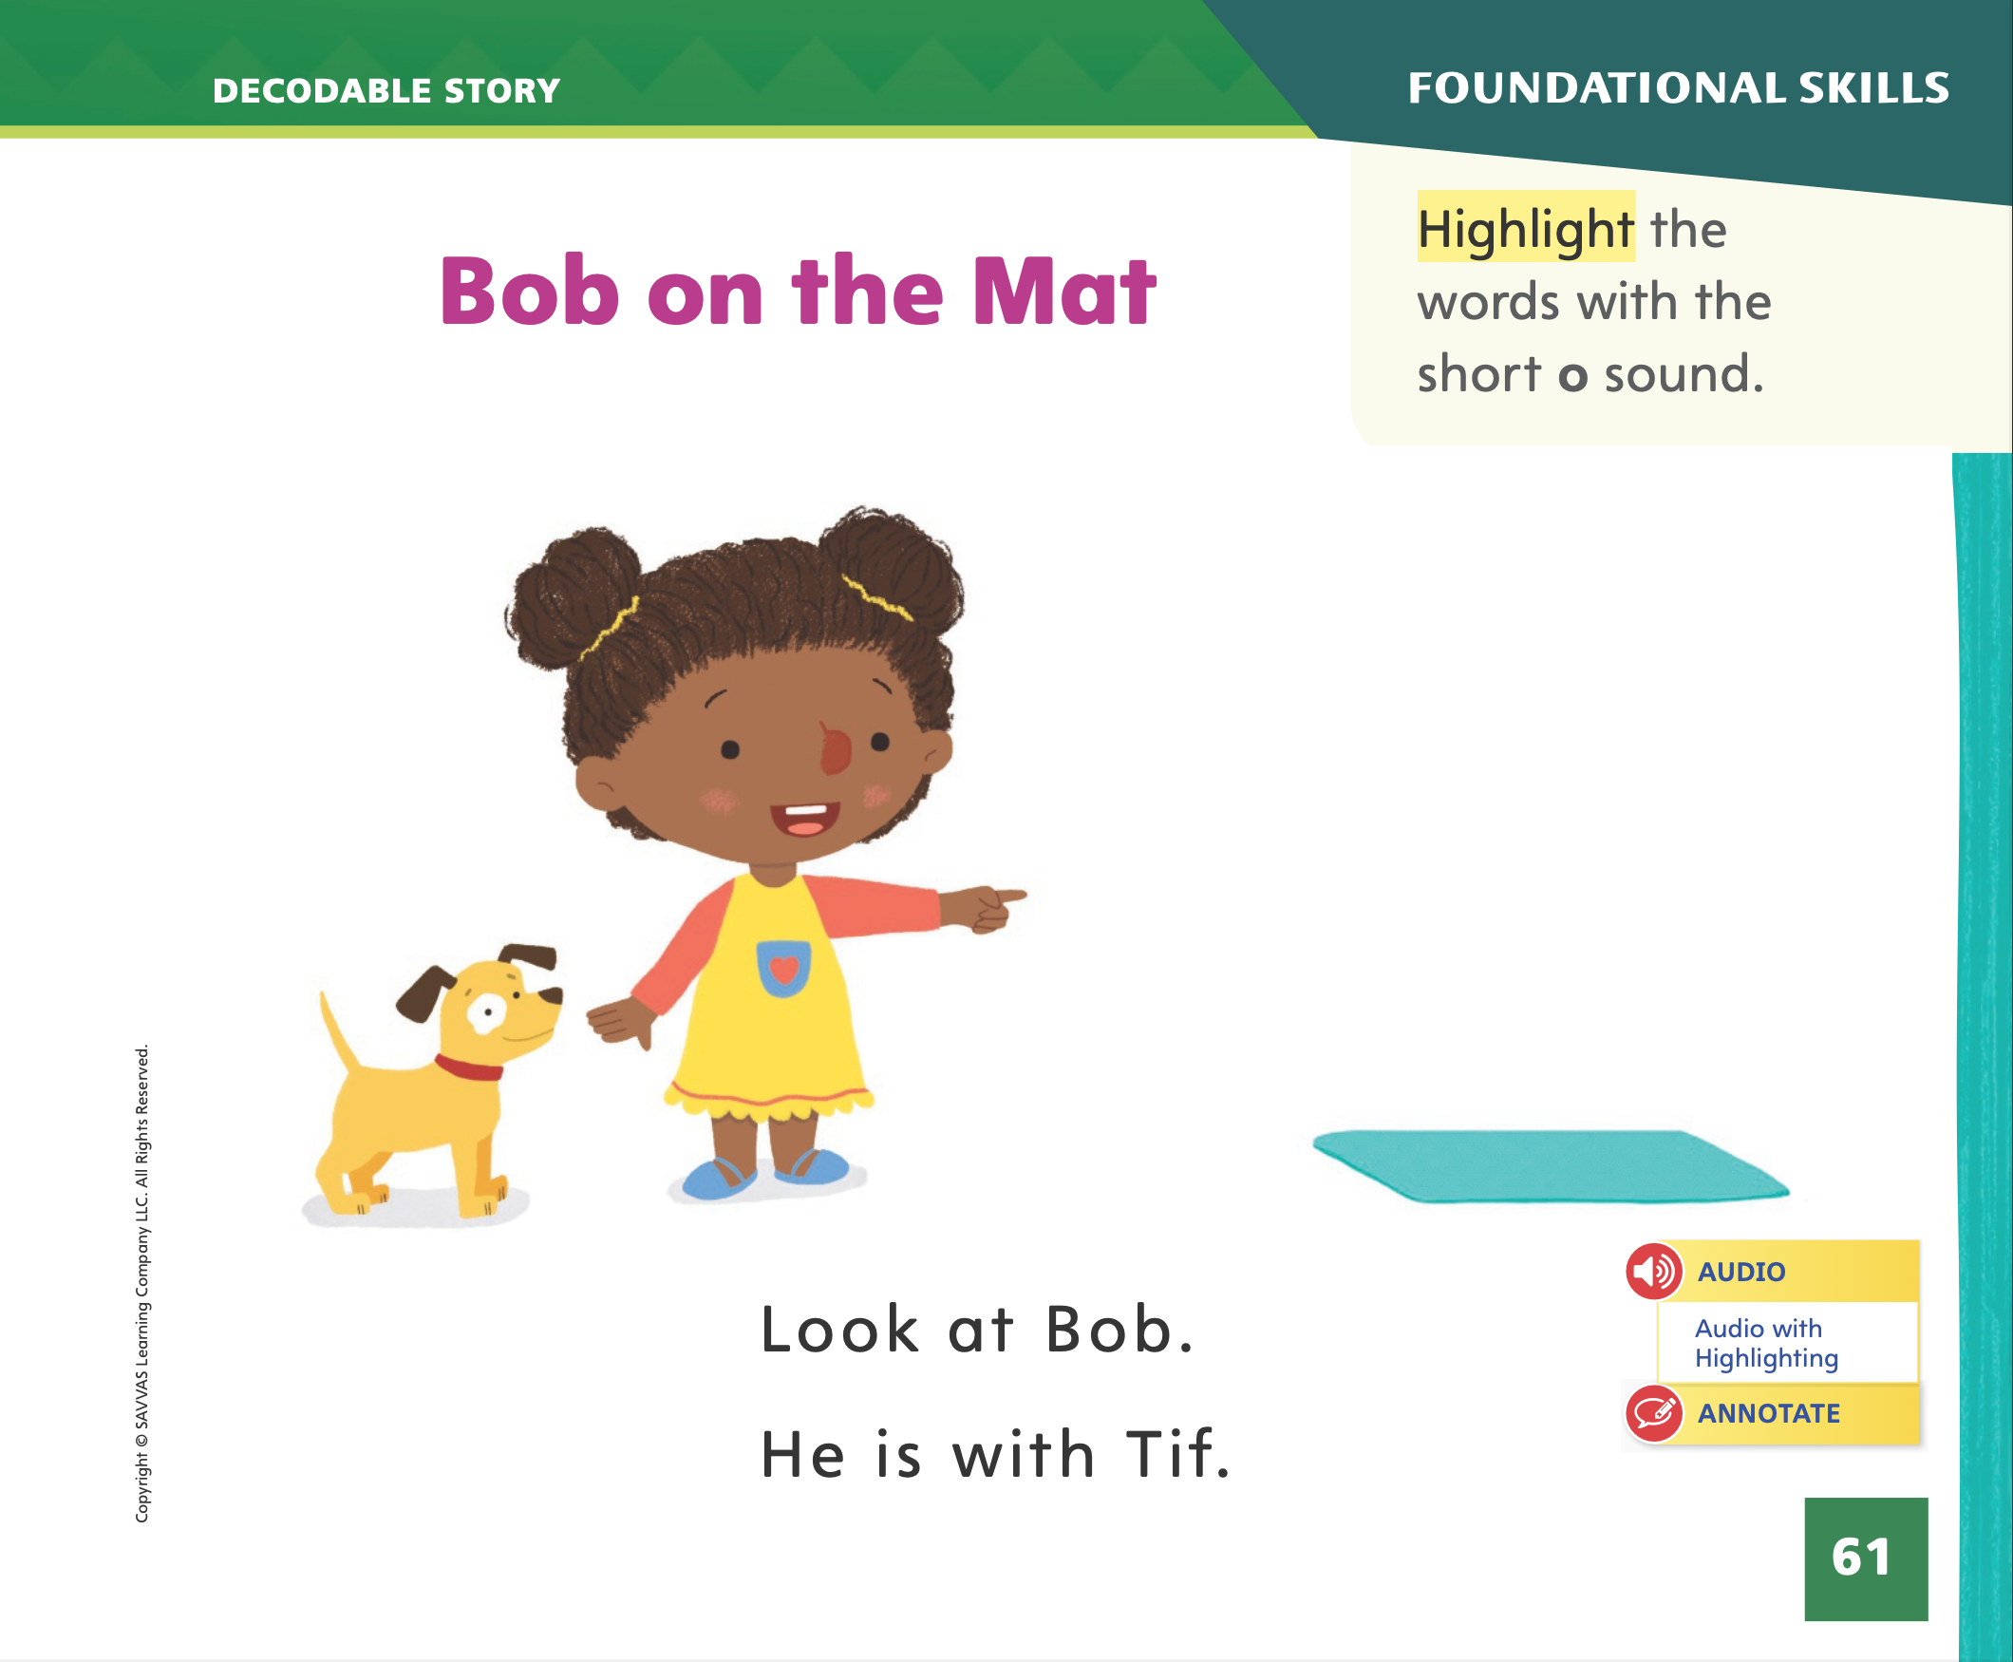
Page 61
Decodable Story
do
you
they
Turn to page 61 in your Student Interactive. Read “Bob on the Mat”.
Notes:
Have students turn to p. 61 in the Student Interactive. We are going to read a story today about a girl named Tif and a dog named Bob. Point to the title of the story.
The title of the story is Bob on the Mat. I hear the short o sound in the word Bob. In this story, we will read other words with the short o sound and words with the sound /f/ spelled f.
Review this week’s high- frequency words: do, you, they. Tell students they will practice reading these words in the story Bob on the Mat. Display the words. Have students read them with you. When you see these words in the story Bob on the Mat, you will know how to identify and read them. You will also see some other Words to Know we've learned: is and the.

Slide 49
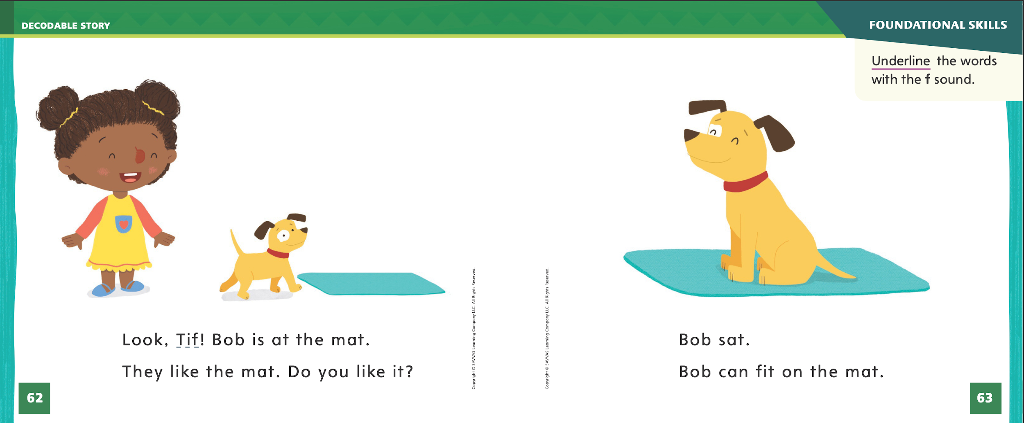
Page
62,63
Decodable Story
Notes:
Have students whisper read the story as you listen in.
Next, have students reread the story page by page with a partner. Listen carefully as they use letter- sound relationships to decode the VC and CVC words. Partners should reread the story. This time the other student begins.
After students have read the story, call their attention to the title. I see the letter o in two of the words. What sound does the letter o spell? Help them identify, or say, the sound /o/.
Then have them identify and match sounds and letters by finding and highlighting the words with the sound /o/ spelled o on p. 61.
Have students turn to pp. 62–63.
Which words include the sound /f/?
Students should supply the words Tif and fit.
How do you know these words include the sound /f/?
Students should say that the words have the letter f, and the letter f spells the sound /f/. They should underline each word with lowercase letter f.

Slide 50
Page 69
Close Read – Ask and Answer Questions
Notes:
Tell students that asking and answering questions before, during, and after they read can help them better understand a text. Some examples of questions that students could ask are:
What do I think the text will be about?
How are the steps in the sequence related?
What did I learn from the text?
Say: Asking questions can help you better understand a text. Before reading From Nectar to Honey, I looked at the pictures and wondered if the text would be about bees. When reading, I had some questions about the sequence of events. After reading, I often ask myself what I learned from reading the text.
Have students go back to the Close Read note on p. 75 in the Student Interactive. Have students generate questions about the text and highlight the answers to their questions. Provide assistance as needed.

Slide 51
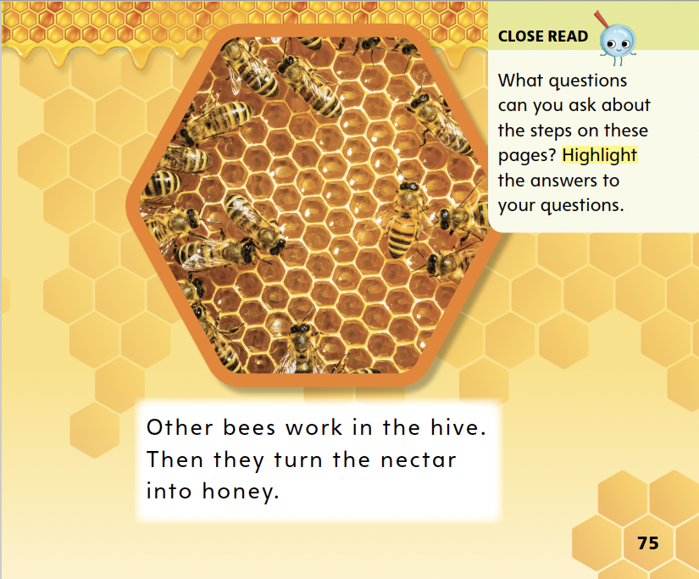
Page 75
Close Read – Ask and Answer Questions
Turn to page 75 in your Student Interactive.
Notes:
Ask students to read the Close Read note on p. 75 of the Student Interactive. Prompt them to ask questions about the steps of making honey. Have students highlight the answers to their questions. DOK 3

Slide 52
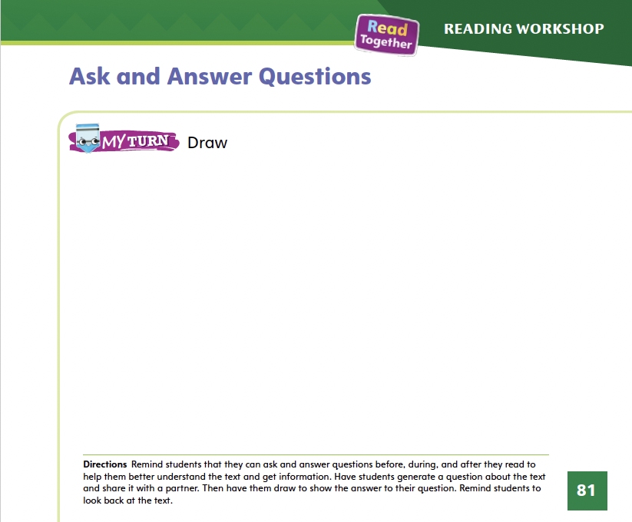
Page 81
Ask and Answer Questions
Turn to page 81 in your Student Interactive and complete the activity.
Notes:
Have students use the strategies for asking and answering questions by drawing a picture that shows the answer to one of their questions.
Have students complete p. 81 in the Student Interactive.

Slide 53
Writing – List Book
  Name the main idea and identify the details about the main idea.
Notes:
Authors write details about their main idea. Details tell more information, such as facts and examples, about the main idea.
Hold up a book from your stack. The author of this book wrote details. The details tell more about the main idea. Name the main idea aloud and tell students to listen for supporting details as you read the text to them.
After reading, return to the beginning of the book and point out the first detail about the main idea. Then call on students to name more details they heard about the main idea. Authors choose a main idea, and then they write details about the main idea. When you write your list book, you should also include details. Continue the activity with other stack books until students are able to identify details.

Slide 54
Independent Writing
You will continue to work on your books, writing details that tell more about your main idea.
Notes:
Tell students that they should write details that tell more about their main idea.
WRITING SUPPORT
Modeled Do a Think Aloud to model how the details support the main idea of a text.
Shared Help students write the main idea of a text. Then work with them to identify details from the text.
Guided Ask guiding questions to help students write details based on the main idea. (Intervention Refer to the Small Group Guide for support.)
If students have written their details already, have them use this time to review the details in their books based on the minilesson and then continue writing.
As students write, use the conference prompts in the Teacher’s Edition or Resource Download Center to provide support. Click path: Table of Contents -> Resource Download Center -> Writing Workshop Conference Notes
Call on a few students to share one detail about their books’ main ideas.

Slide 55
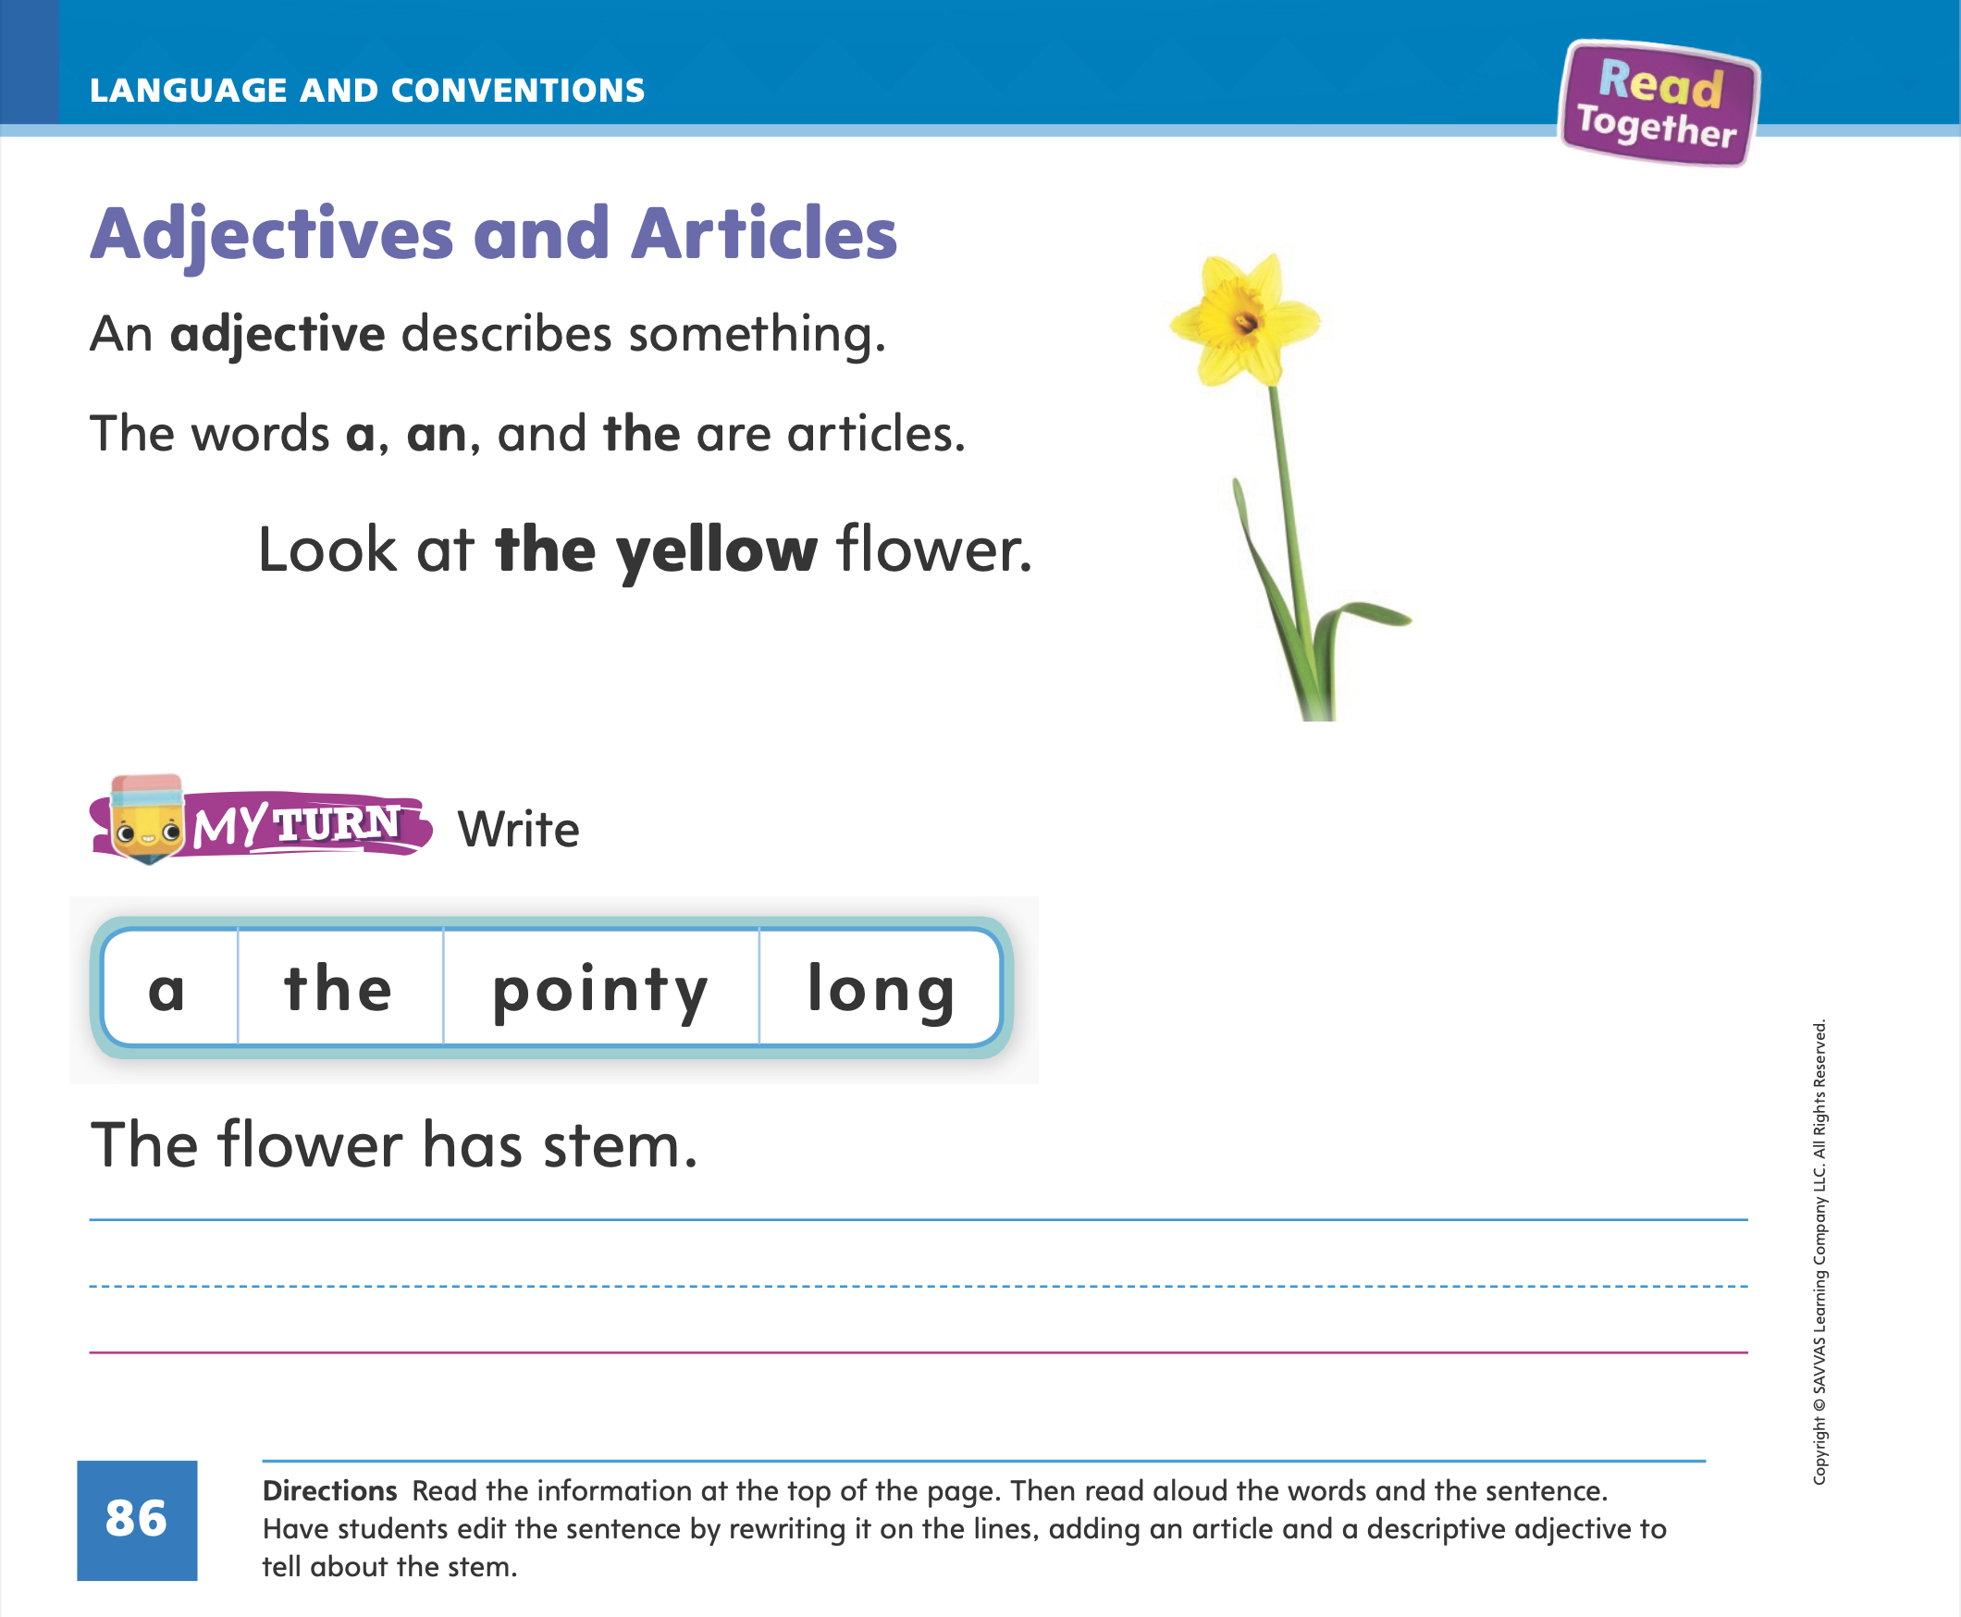
Page 86
Language and Conventions
Turn to page 86 in your Student Interactive and complete the activity.
Notes:
Have students edit for an article and adjective on p. 86 in the Student Interactive.

Slide 56
Lesson 5

Slide 57
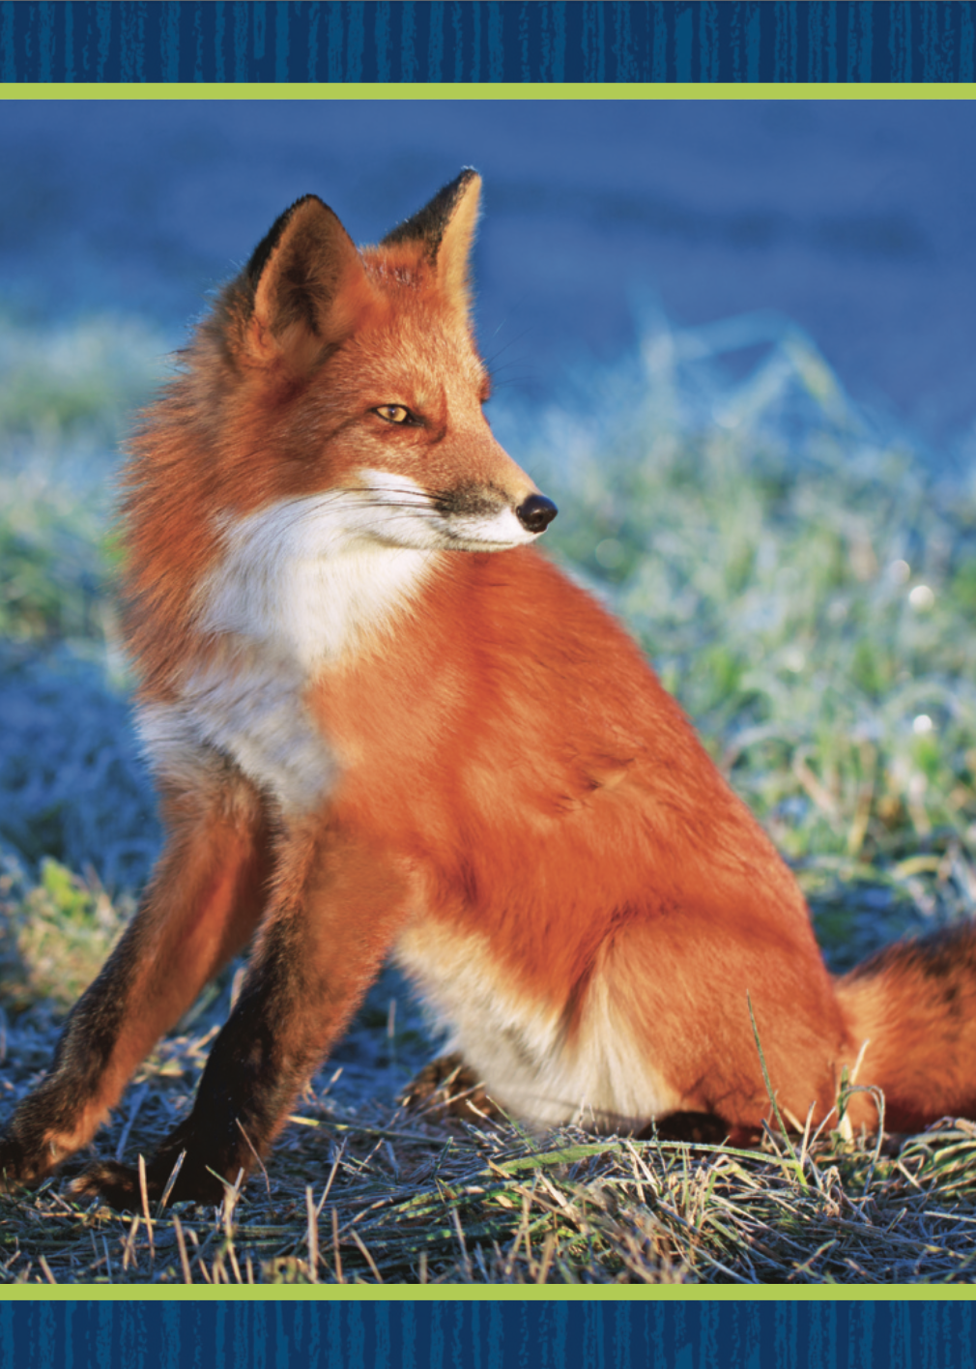


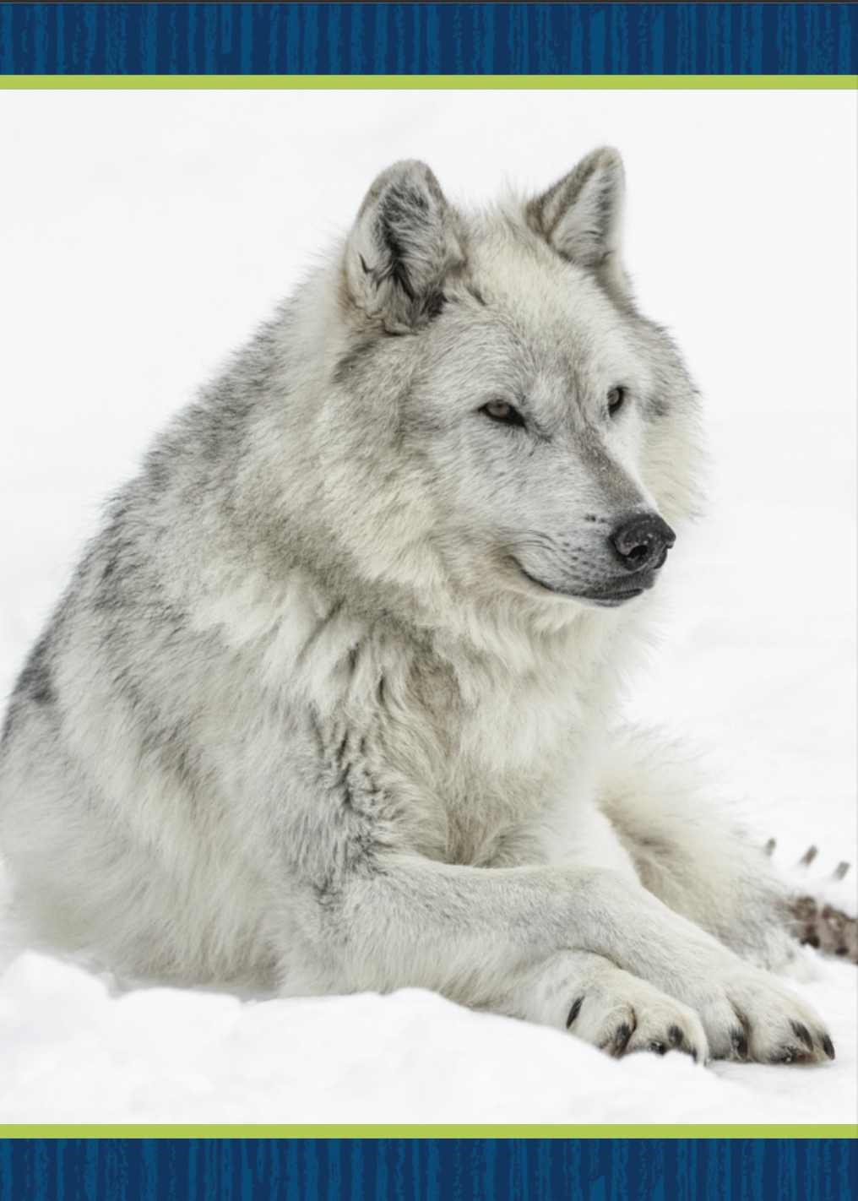
Phonological Awareness
Notes:
Display the fox Picture Card. Listen as I say this word: fox. What is the first sound in fox? Say it with me: /f/ -ox.
Hold up the leaf Picture Card. Listen as I say this word: leaf. What is the last sound in leaf? Say it with me: lea- /f/. What sound is at the beginning of the word fox? What sound is at the end of the word leaf?
Place the Picture Cards fox and leaf at the front of the room. Display the five Picture Card and say the word: five. Ask a student to repeat the word and place the card next to the fox if it begins with the sound /f/, or next to the leaf if it ends with the sound /f/. Repeat with the Picture Cards for roof, feather, fan, wolf. Click path -> Table of Contents -> Unit 2 Week 2 Informational Text -> Lesson 5

Slide 58
Phonics
cot
mop
Oo
Ff
Tom
fan
fit
top
fin
fad
Notes:
Write the letters Oo and Ff on the board. Have students identify the letters as you point to them.
Then review the sound for each letter: o/o/, f/f/. Ask students to say the sound as you point to each letter.
Divide the class in half. One half is the F-Team, the other is the O-Team. Place teams on opposite sides of the room. Write the words cot, mop, Tom, fan, fit, top, fin, and fad on the board. We will read these words together. If you hear the /f/ sound, the F-Team will applaud. If you hear the /o/ sound, the O-Team will applaud. Point to each letter as you read each word aloud. Let’s read the first word together: /k/ /o/ /t/. Repeat using the rest of the words.

Slide 59
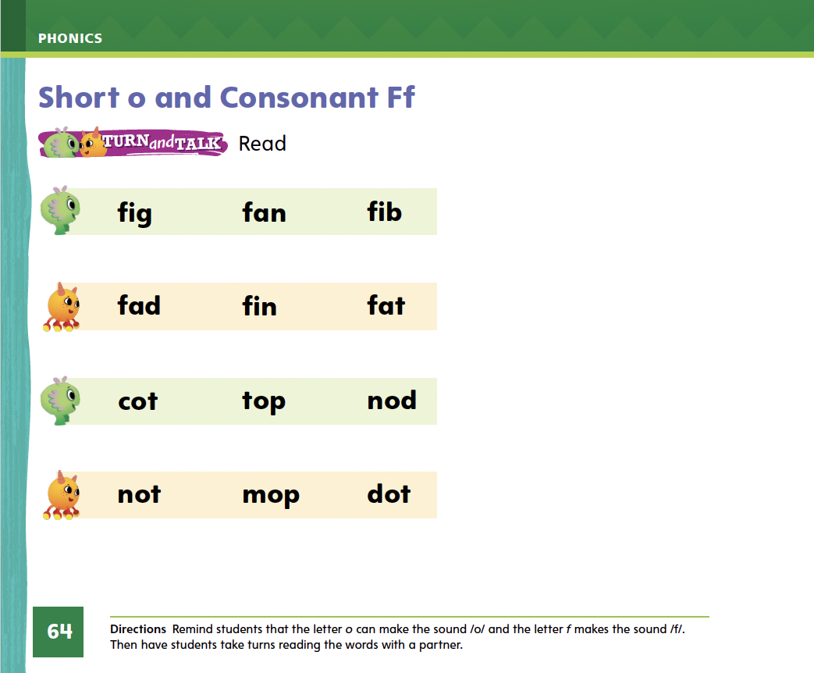
Page 64
Phonics
Turn to page 64 in your Student Interactive.
Notes:
Have students turn to p. 64 in the Student Interactive and read these words with a partner.

Slide 60
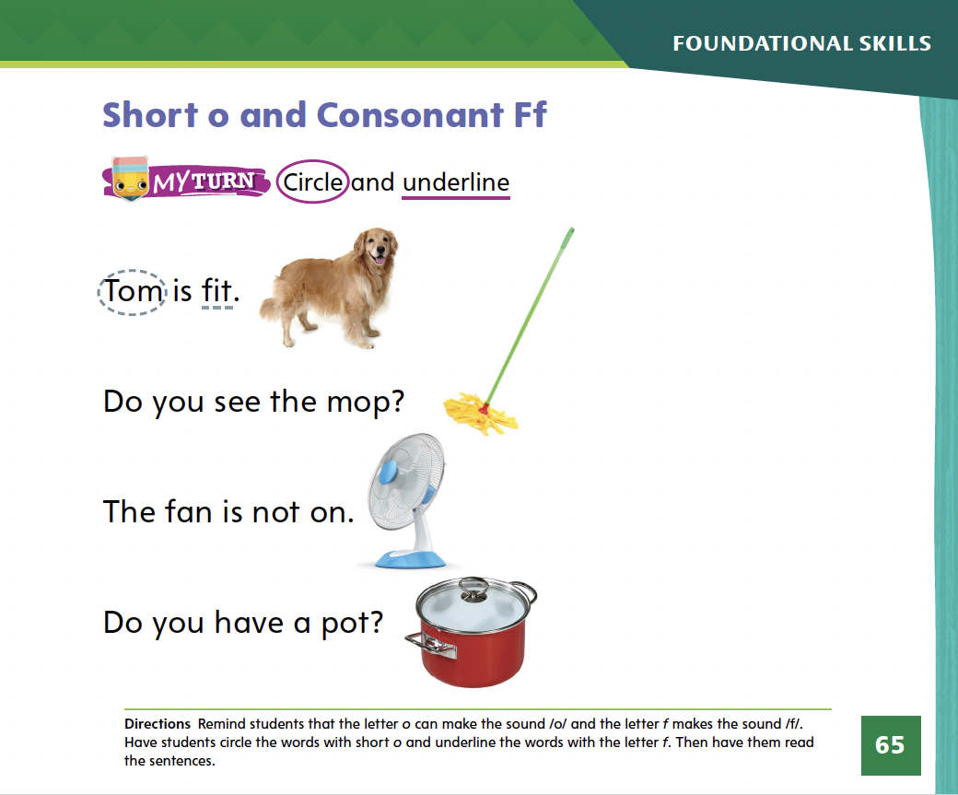
Page 65
Apply
Turn to page 65 in your Student Interactive and complete the activity.
Notes:
Have students look at p. 65 in the Student Interactive. Have them circle the words with short o and underline the words with the letter f. Then have them read the sentences and draw a line to match the sentences with the corresponding pictures.

Slide 61
High-Frequency Words
they
you
do
Notes:
Remind students that high- frequency words are words that appear over and over in texts. Say the word do and ask students what letters spell the word.
Have students
say the letters as you write them on the board.
repeat with you and they.
read the words aloud.

Slide 62
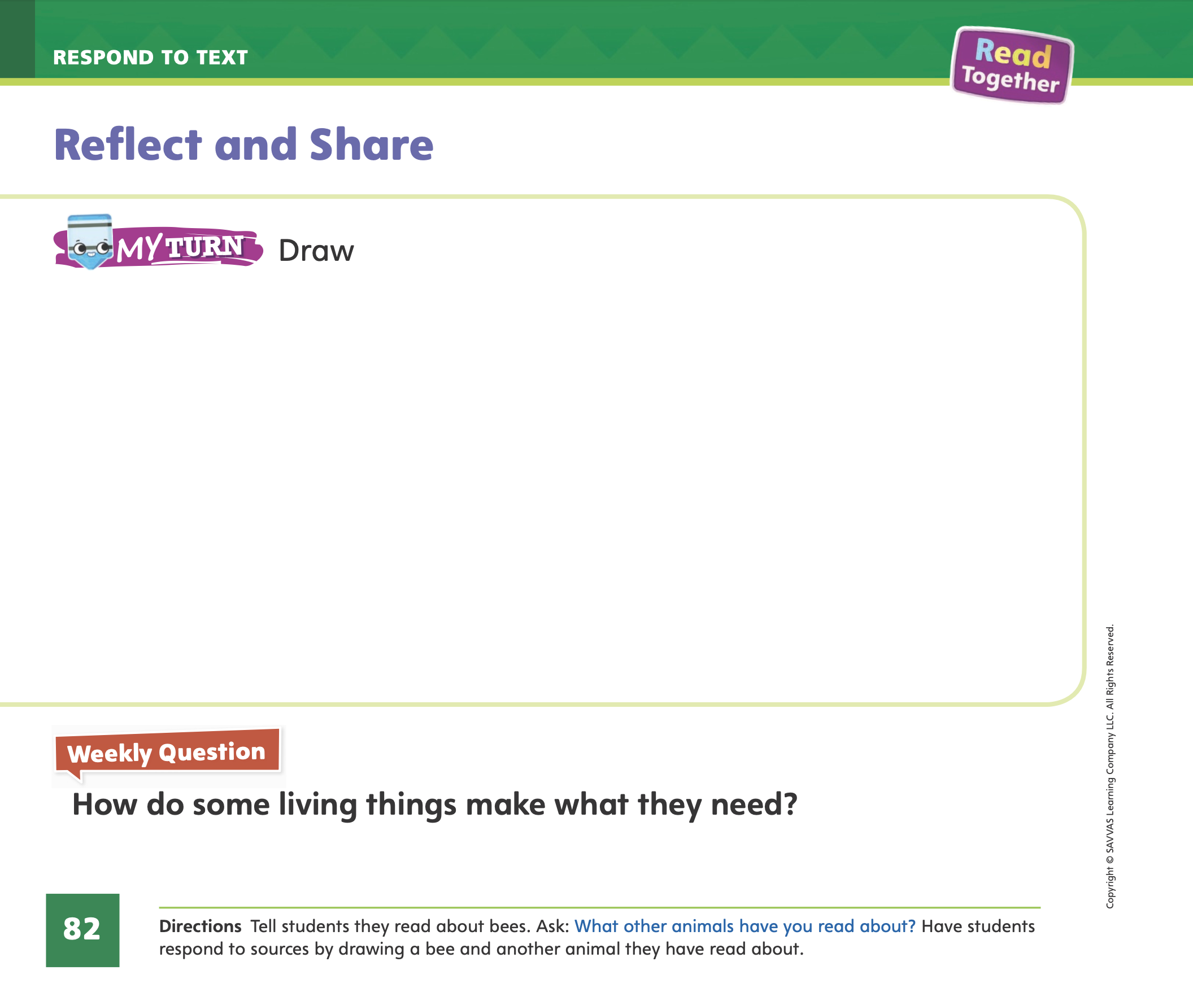
Page 82
Reflect and Share
Turn to page 82 in your Student Interactive.
Notes:
Tell students that sometimes they may visually respond to a text they read. When they draw a picture, they can share ideas and information. They can also compare different texts they have read and consider how different authors write about similar subjects.
Students should
make sure they understand what the texts are about.
think about ideas or information they could share in their drawings.
Model sharing ideas and information about the topic using the Weekly Question on p. 82 in the Student Interactive. I know that living things need air, water, food, and shelter. In From Nectar to Honey, we read that bees make honey for food. In Animals on the Move, we read about geese migrating to find food. I could share that information in a picture.

Slide 63

Page 82
Apply
How do some living things make what they need?
Notes:
Weekly Question: Have students use evidence from the texts they have read this week to respond to the Weekly Question.
Tell them to write their responses on a sheet of paper or discuss in small groups.

Slide 64
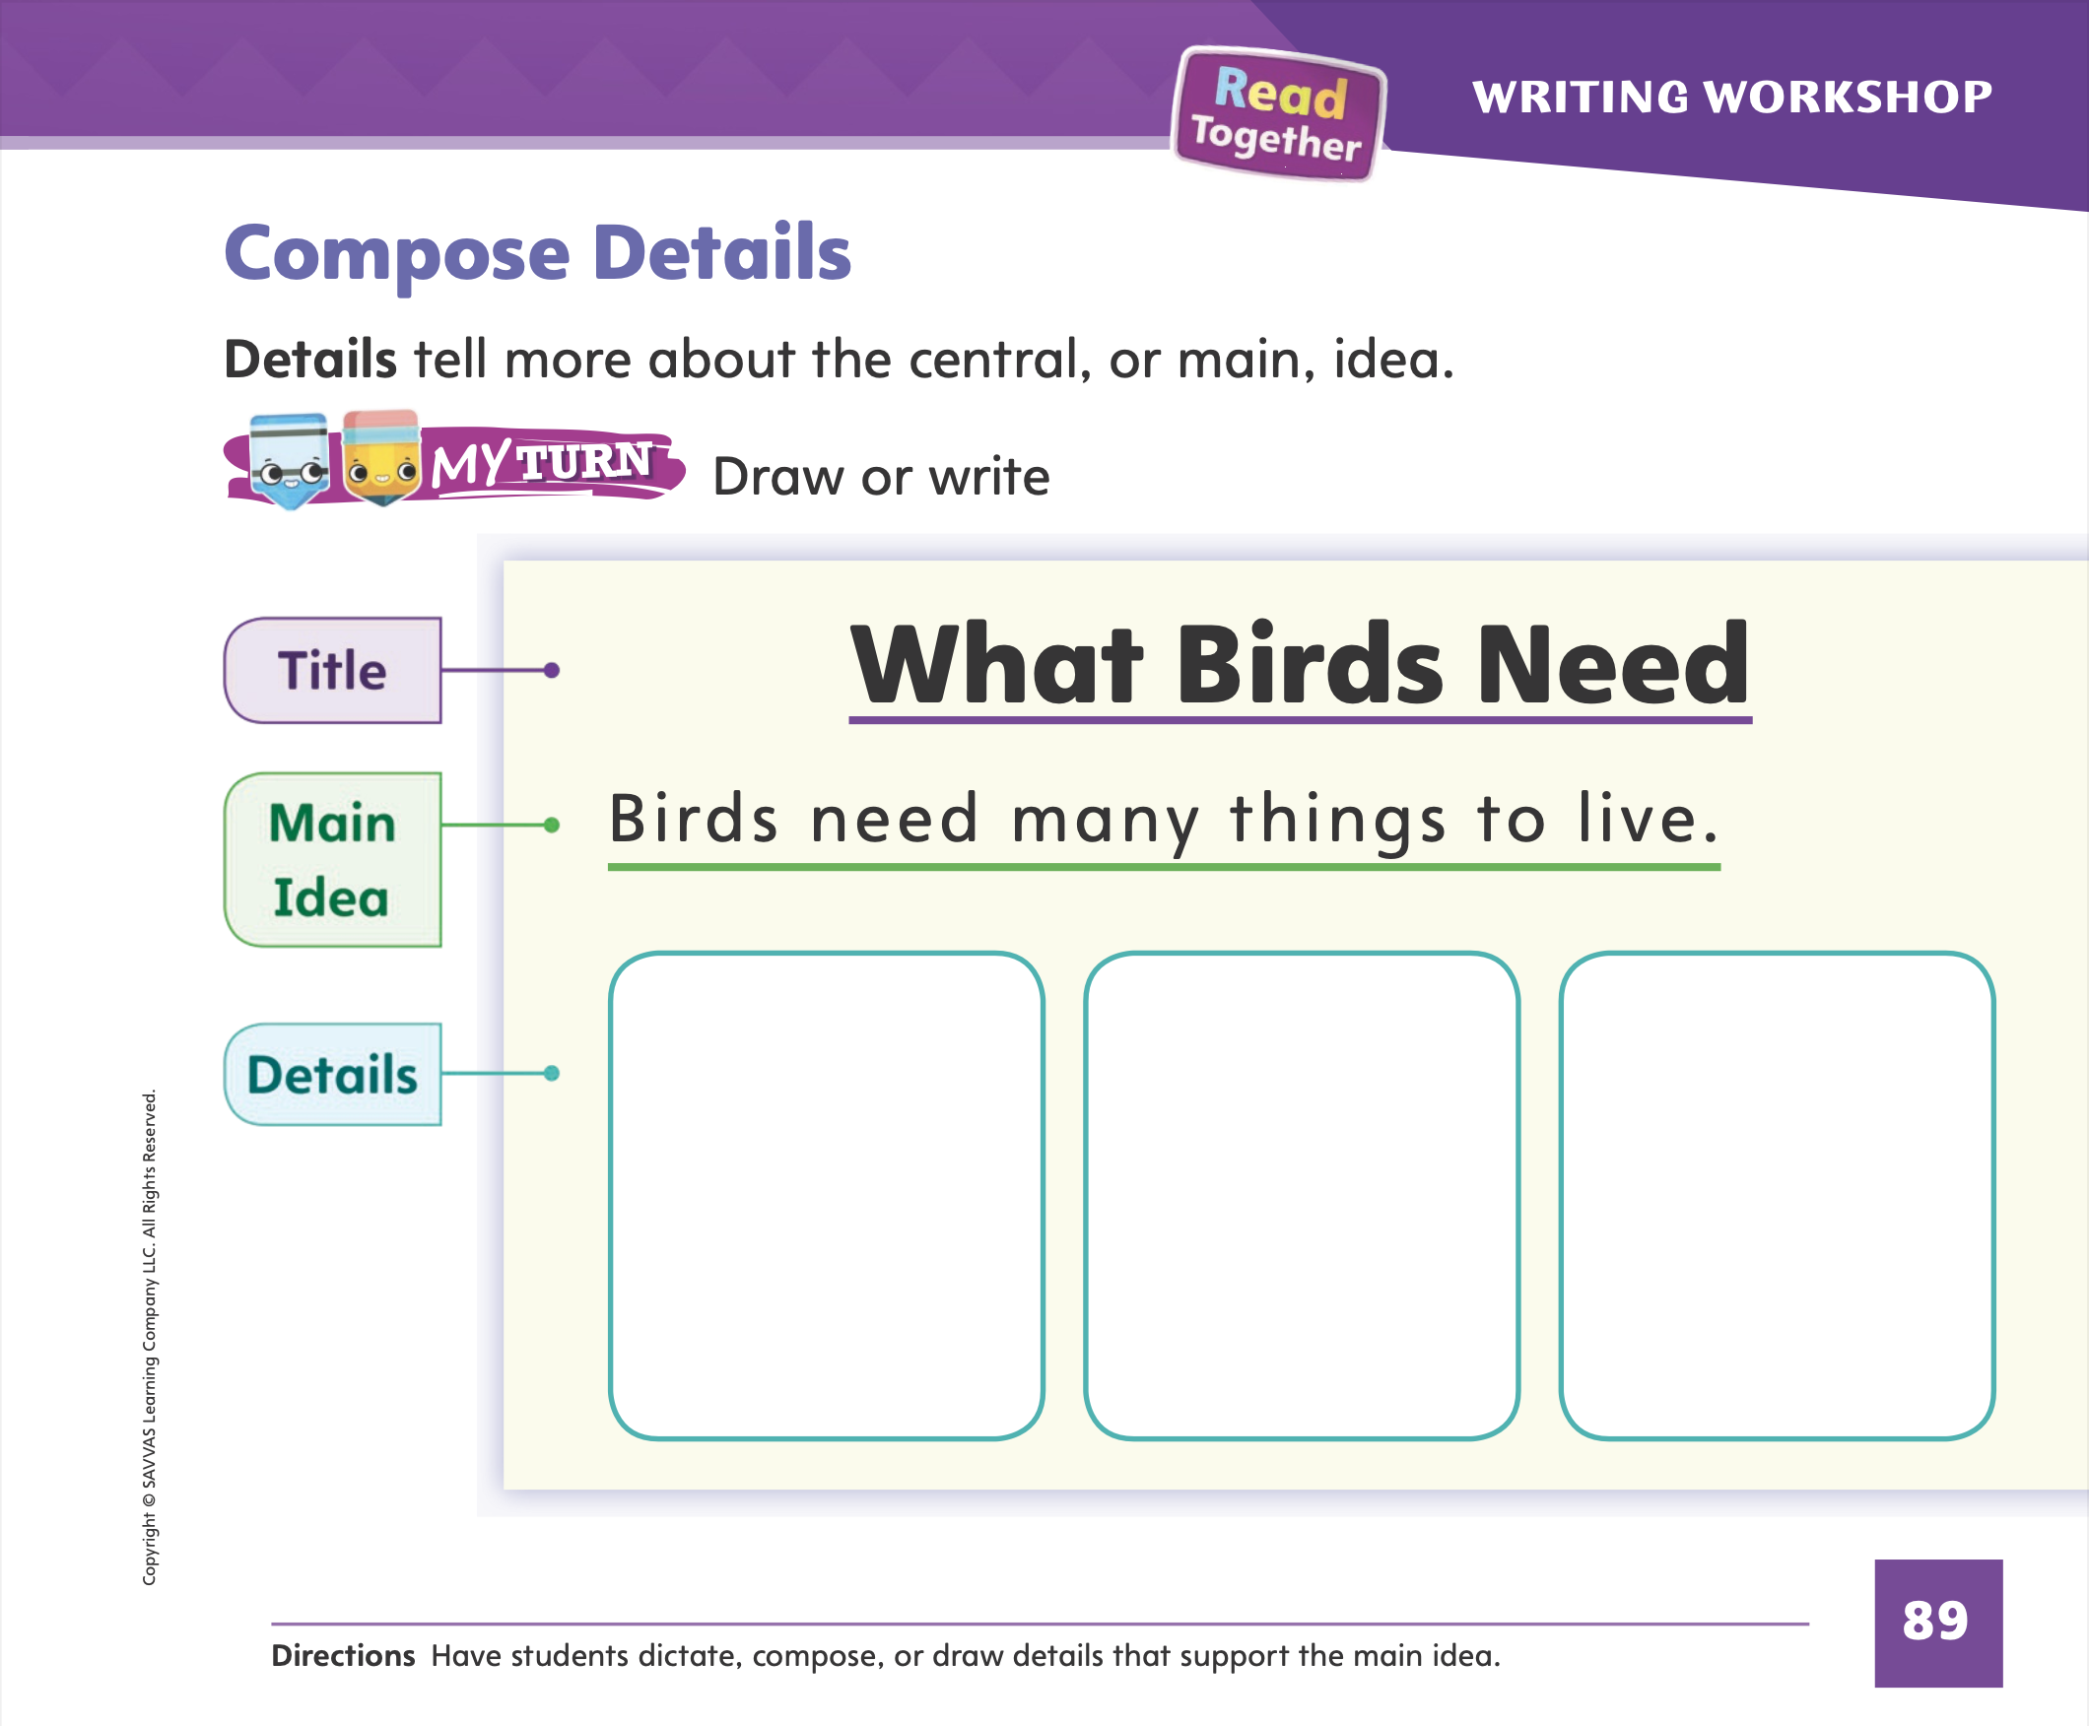
Page 89
Writing – List Book
Turn to page 89 in your Student Interactive and complete the activity.
Notes:
Details are the facts and information that tell more about a main idea. An author writes details to supply more information about the topic.
Look at a book from your stack together. Remind students that a detail tells more about the main idea. Read the stack book with your students and help them identify details in the text. Then ask them to tell what main idea those details are mostly about.
Tell students that you are composing a list book about the colors of the rainbow. The main idea of my book is that there are many colors in the rainbow. What details should I include in my book? The details should tell more about the main idea, so they should tell the colors of the rainbow. Work with students to compose an informational text about the colors of the rainbow.
Have students turn to p. 89 of the Student Interactive. Read the page together and have them draw details to support the main idea.

Slide 65
Language and Conventions
I have a red ball.
Which word in the sentence is an article?
I
and
red
ball
Notes:
Display the following sentence and guide students to complete the question. (1) I have a red ball.
Which word in the sentence is an article?
I
a
red
ball
Have students complete Language and Conventions, p. 87, from the Resource Download Center. Click path: Table of Contents -> Resource Download Center -> Language and Conventions -> U2 W2

Slide 66
Unit 2: Week 2
Grade K

